Slide 1
Exploiting Application Characteristics for Efficient System Support of Data-parallel Machine Learning
Henggang Cui
PARALLEL DATA LABORATORY
Carnegie Mellon University
Notes:
My thesis is about exploiting application characteristics for efficient system support of data parallel machine learning.

Slide 2



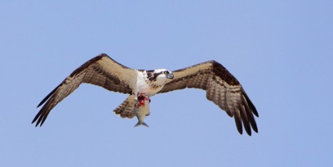
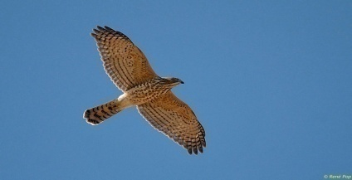
Machine learning
Labelled images
Deep neural network
Eagle
Vulture
Read/Update
params
Osprey
Accipiter
Machine learning program
Model parameters (solution)
Training data
Notes:
I will start with some background on data parallel machine learning training. Here I will use the image classification application as an example. Suppose we want to train a deep neural network model to classify images, and the training data is a lot of labelled images.
(HIT) And the goal of the machine learning task is to learn the model parameters of the machine learning model, from the training data. It will go through the training data for many iterations, until the model converges.

Slide 3
Data-parallel machine learning
Eagle
Parameter server
Vulture
Read/Update
params
Osprey
Accipiter
Partitioned
Training data
Distributed
ML workers
Shared
model parameters
Notes:
When we have a very deep neural network and lots of training images, we want to make it parallel across a cluster of machines. To do that, we can partition the training data across multiple training workers. Suppose we have two workers, each worker will get half of the training data. The two workers will collaboratively train the shared model parameters.
(HIT) To do that efficiently, one popular approach is to use a parameter server system to manage those shared model parameters.
The goal of our work is to design efficient parameter server systems to for data parallel machine learning.

Slide 4
Thesis statement
The characteristics of large-scale data-parallel machine learning computations can be exploited in the implementation of a parameter server to increase their efficiency by an order of magnitude or more.
Notes:
(SLOW) This is my thesis statement. We believe that the characteristics of data parallel machine learning can be exploited in the implementation of parameter server systems to improve the efficiency by over an order of magnitude.

Slide 5
Three case studies
IterStore [Cui et al. SoCC ‘14]
an efficient parameter server design
exploits repeated parameter data access
GeePS [Cui et al. EuroSys ‘16]
specialized parameter server for GPU deep learning
exploits layer-by-layer pattern of deep learning
MLtuner [In preparation]
system for automatic machine learning tuning
exploits quick decision of training hyperparam tuning
Notes:
To support this thesis statement, I will describe three pieces of my PhD research work, as three case studies.
The first work, IterStore, is an efficient parameter server design. It exploits the characteristic of repeated data access of many machine learning computations.
The second work, GeePS, is a parameter server design specialized for GPU deep learning, and it exploits the layer-by-layer pattern of deep learning computation.
The third work, MLtuner, is a system for automatic machine learning tuning. It exploits the characteristic that the training hyperparameters can be often be decided quickly during the training.

Slide 6
Three case studies
IterStore [Cui et al. SoCC ‘14]
an efficient parameter server design
exploits repeated parameter data access
GeePS [Cui et al. EuroSys ‘16]
specialized parameter server for GPU deep learning
exploits layer-by-layer pattern of deep learning
MLtuner [In preparation]
system for automatic machine learning tuning
exploits quick decision of training hyperparam tuning

Slide 7
Traditional parameter server design
Traditional PS is like a generic key-value store
data organized as a collection of key-value pairs
accessed with Read and Update interface
ML app worker 0
Parameter server
Read/Update
ML app worker 1
Notes:
Traditionally, a parameter server is pretty much like a generic key-value store. The parameter server manages the parameter data as a collection of key-value pairs, indexed the key. The parameter server provides read and update interface for the application workers to access the parameter data.

Slide 8
Traditional parameter server design
Traditional PS is like a generic key-value store
data organized as a collection of key-value pairs
accessed with Read and Update interface
sharded distributedly and co-located with ML workers
assumes no knowledge of the access pattern
ML app worker 0
Parameter server shard 0
Parameter server shard 1
ML app worker 1
Notes:
Because a single parameter server machine will be a performance bottleneck, people often shard the parameter data across multiple parameter server shards.
(HIT) Also, because the parameter server shards have very little computational work, we don’t need to dedicate separate parameter server machines. Instead, people often put the parameter server shards in the same set of machines as the machine learning workers.
Besides those, the traditional parameter server makes no assumptions on the access pattern of machine learning workers.

Slide 9
Repeated data access in ML applications
Example application: PageRank
Parameter data: ranks of pages, stored in parameter server
Page-0
Link-0
Worker-0
Init ranks to random value
LOOP
FOREACH link from i to j
Read rank[i]
rank[j] += change of rank[i]
ENDFOREACH
WHILE NOT CONVERGE
Link-2
Link-3
Page-2
Link-1
Worker-1
Page-1
Notes:
But however, we find that many machine learning applications have an important characteristic that they apply the same sequence of parameter data access every iteration. I will explain that with a simple PageRank example.
For this PageRank application, we want to compute the ranks of the webpages in the web graph. The rank of each webpage is decided by the ranks of its neighbor pages. The algorithm is quite simple. We first initialize all ranks to some random value, and then, for every iteration, we go through all the links in the graph. (POINT) For every link, we will update the rank of the destination page according to the rank of the source page. We will do many such iterations, until the ranks converge.
(HIT) To do that in a data parallel way, we can partition all the links in the graph evenly across all the workers. And we keep the rank data in the parameter server.

Slide 10
Repeated data access in ML applications
Example application: PageRank
Parameter data: ranks of pages, stored in parameter server
Page-0
Worker-0:
LOOP
# Link-0
Read rank[2]
Update rank[0]
# Link-1
Read rank[1]
Update rank[2]
Clock
WHILE NOT CONVERGE
Link-0
Worker-0
Link-2
Link-3
Page-2
Link-1
Worker-1
Param access depends only on the model
Does not depend on param values
Page-1
Notes:
When we look at the parameter data access of worker 0. We find, in every iteration, it always first reads the rank of page 2, updates the rank of page 0, and then reads the rank of page 1, and updates the rank of page 2.
The same data access sequence repeats every iteration. That is because this access sequence is only dependent on the structure of the graph, and is *usually* not dependent on the current parameter values.

Slide 11
Repeated data access sequence
Many examples of ML applications
including deep learning, matrix factorization and LDA
Knowledge of repeated access sequence can be exploited to improve efficiency
Notes:
This repeated access pattern is widely observed in many other machine learning applications, such as deep learning, LDA, and matrix factorization.
Our IterStore system will exploit this knowledge to greatly improve its performance.

Slide 12
Obtain per-iter sequence via a virtual iteration
// Original
LoadTrainingData()
do {
DoIteration()
} while (not stop)
Notes:
We first designed a method to get the access sequence from the application, and we call it virtual iteration.
At the left hand side is the basic structure of a machine learning program. It first loads the training data from the file system, and then it starts the iterations. Inside this do iteration function, it will use our parameter server APIs to read and update the parameter data.

Slide 13
Obtain per-iter sequence via a virtual iteration
// With virtual iteration
LoadTrainingData()
ps.StartVirtualIter()
DoIteration()
ps.FinishVirtualIter()
do {
DoIteration()
} while (not stop)
// Original
LoadTrainingData()
do {
DoIteration()
} while (not stop)
Calls in virtual iter. are recorded with no action taken
almost no overhead
Notes:
At the right hand side is the machine learning program with the virtual iteration. We just need to add this three lines of code to the original code. After the application finishes loading the training data, its parameter data access will be already determined. So we let the application explicitly report its access sequence to the parameter server, by doing one iteration virtually.
This iteration is virtual, because during the virtual iteration, all the parameter server calls are only remembered by the parameter server, and it does no actions on it. For example, when the worker makes a Read call during the virtual iteration, the parameter server will just remember this read call, and return with no data. This design works, because usually the control flow of the application code is only dependent on the structure of the model, and it is not dependent on the actual parameter values.

Slide 14
Optimizations on informed access
Many optimizations applied after virtual iteration
1. parameter data sharding with better locality
Machine-0
Machine-1
ML Worker-0
ML Worker-1
PS shard-0
PS shard-1
Notes:
Our parameter server will use the reported access sequence as a hint, and apply many optimizations for the informed access.
For example, we can shard the parameter data across the parameter server shards with better locality. Here is an example setup of two machines. Each of the two machine runs one machine learning worker and one parameter server shard. Those color boxes are the parameter data that each worker accesses. When we know the access sequence of the workers. (HIT) We can shard the parameter data in such a way that we can minimize the cross-machine communication traffic. For example, because the red parameter data is accessed most often by the worker at machine zero, we will just put the red parameter data at the parameter server shard of machine zero, to minimize the cross-machine traffic.

Slide 15
Optimizations on informed access
Many optimizations applied after virtual iteration
1. parameter sharding with better locality
2. prefetching
3. specialized caching policies
4. efficient marshalling-free data structures
5. NUMA-aware memory arrangement
Notes:
We have designed many other optimizations for IterStore, such as prefetching, specialized caching policies, efficient marshalling-free data structures, and NUMA-aware memory arrangement.

Slide 16
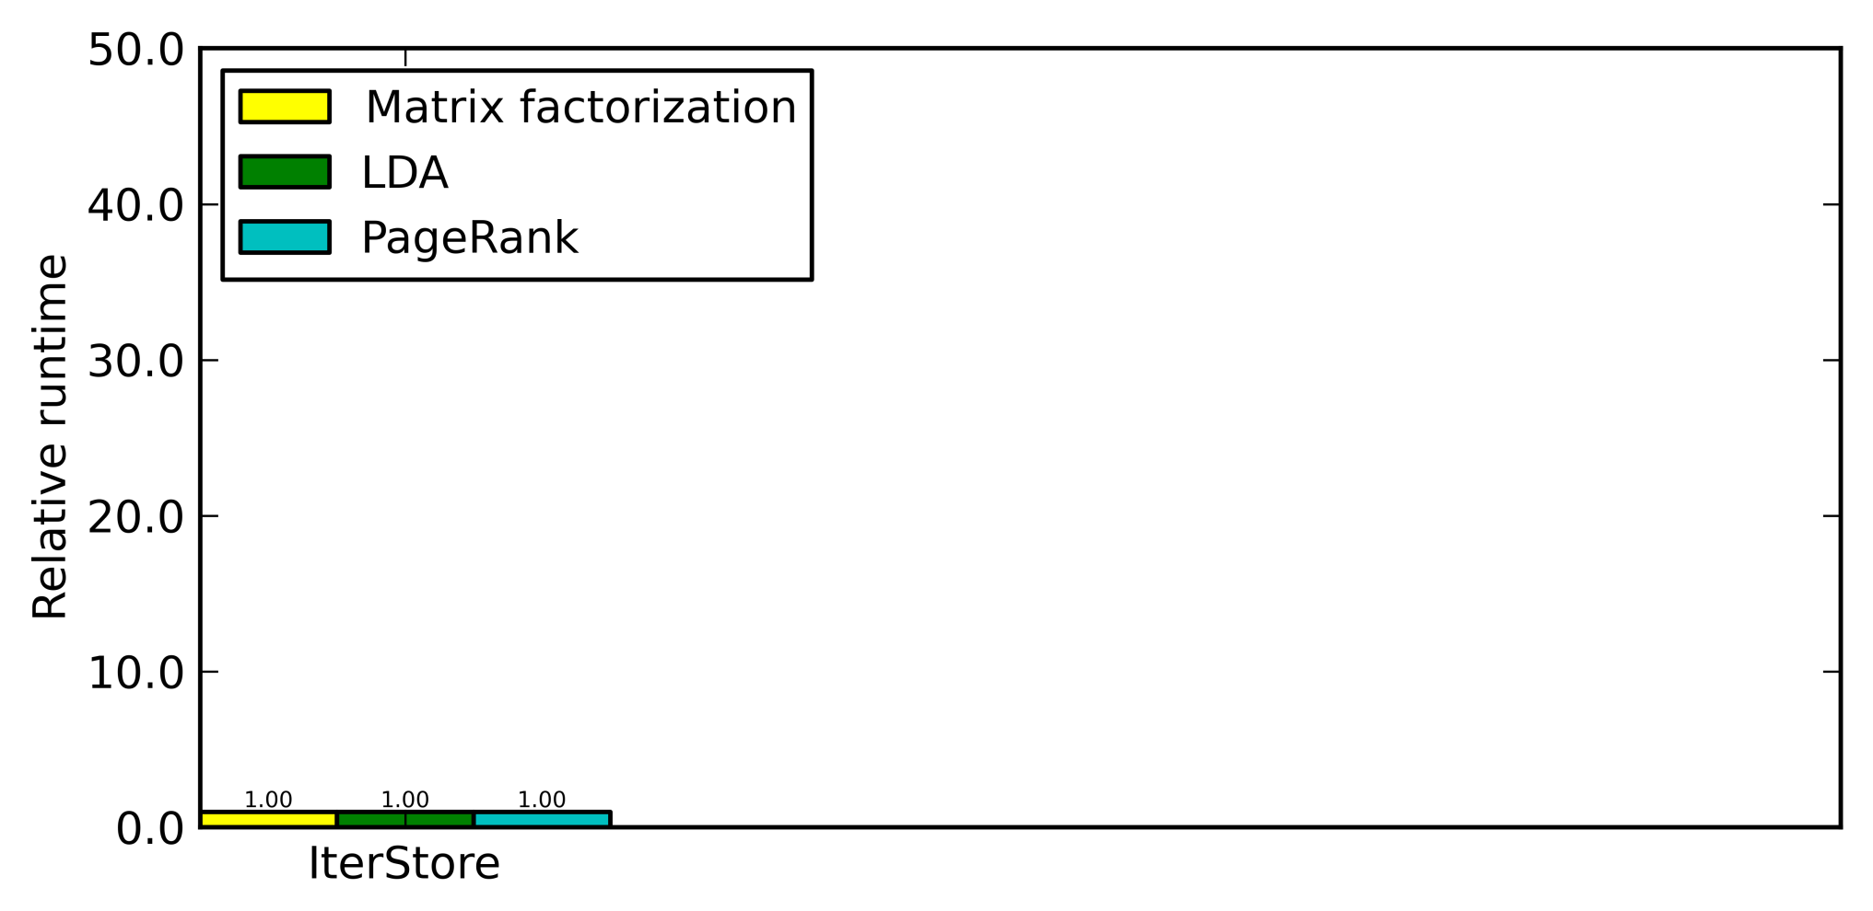
IterStore optimization speedups
matrix factorization: Netflix dataset, rank 1000
LDA: NYTimes dataset, 1000 topics
PageRank: Twitter dataset
Notes:
Next, I will show you the performance improvement coming from those optimizations.
We used three machine learning applications, matrix factorization, LDA, and PageRank. Each bar here is one application.
We will compares the runtime of IterStore with the baselines.
The Y axis is the normalized runtime, and lower is better.

Slide 17
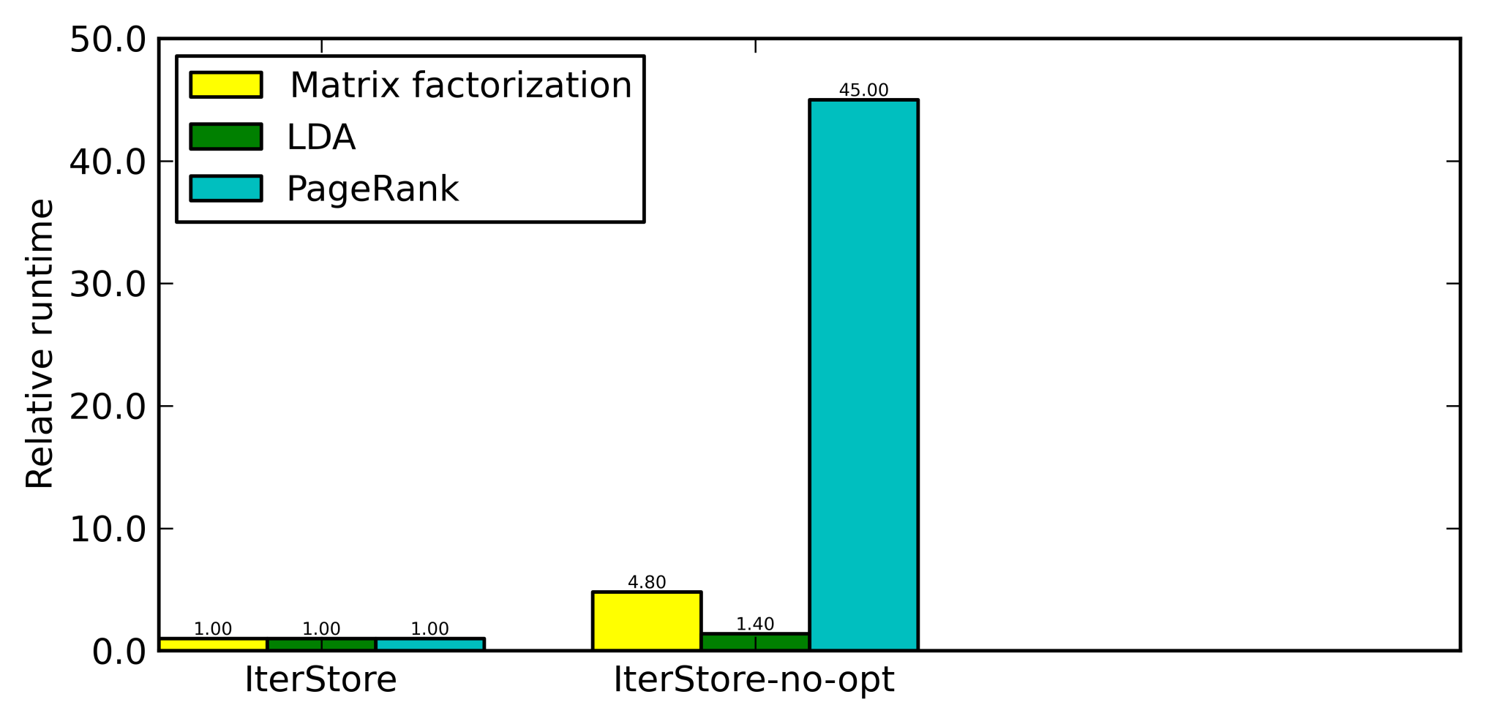
IterStore optimization speedups
45x speedup on PageRank
5x speedup on matrix factorization
Notes:
We first compare the optimized IterStore with the non-optimized version. Compared to the nonoptimized version, IterStore is 45 times faster on PageRank, and 5 times faster on matrix factorization.

Slide 18
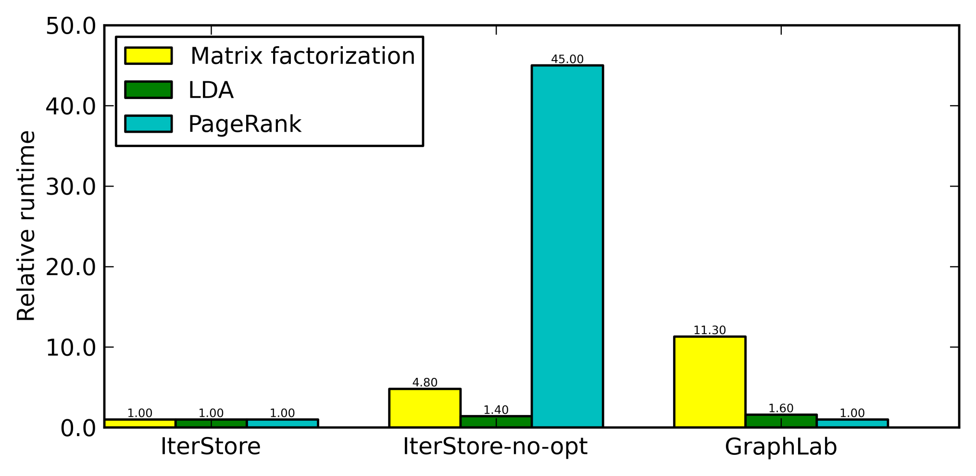
IterStore optimization speedups
faster than GraphLab (state-of-art at that time)
11x faster on matrix factorization
Notes:
We have also compared our IterStore system with GraphLab, which was the state-of-art machine learning system at that time. And we have comparable performance with GraphLab on the PageRank benchmark, but we are much faster than GraphLab on the matrix factorization benchmark.

Slide 19
Take-away messages from IterStore
Many ML applications exhibit iterativeness
same sequence of access every iteration
can be gathered via a virtual iteration
Systems can exploit repeated access
speed up real ML benchmarks by up to 45x
Notes:
To summarize the IterStore work. We find many machine learning applications have the characteristic that they apply the same sequence of parameter data access every iteration. We find this characteristic can be exploited in the design of a parameter server, to greatly improve its efficiency.

Slide 20
Three case studies
IterStore [Cui et al. SoCC ‘14]
an efficient parameter server design
exploits repeated parameter data access
GeePS [Cui et al. EuroSys ‘16]
specialized parameter server for GPU deep learning
exploits layer-by-layer pattern of deep learning
MLtuner [In preparation]
system for automatic machine learning tuning
exploits quick decision of training hyperparam tuning

Slide 21
A machine with a GPU device
Network
CPU cores
Local
storage
...
NIC
GPU device
GPU cores
DRAM
(CPU memory)
GPU
memory
(a few GB)
Small GPU memory
Expensive to copy between GPU/CPU mem
Notes:
I will first give a brief overview of what a GPU machine looks like.
The GPU is often a separate device with many cores and a small device memory, and we call it GPU memory.
(HIT) One of the limitations of GPU computing is that the GPU cores can only accesses the GPU memory. The GPU memory is quite small, only a few gigabytes. We can copy data between GPU memory and CPU memory, but it is very very expensive. Doing this data transfer in the foreground will stall the useful computation.

Slide 22
Single-GPU machine learning
Staging memory
for input data batch
Input data file
(training data)
a mini-batch of training data
Train
data
Intermediate
data
Parameter data
CPU memory
GPU memory (a few GB)
Notes:
(POINT) Next, I will show you the basic structure of a machine learning program using GPUs. In particular, I will focus on where each piece of the data stays, so here is the CPU memory, and here is the smaller GPU memory.
(HIT) The machine learning application will keep all its data in GPU memory. That includes the training data, the intermediate data, and the parameter data.
(HIT) For every iteration, the application will read one batch of the training data to its GPU memory. And it will compute the updates to the parameter data according to the training data, with the GPUs.

Slide 23
Multi-GPU ML via CPU parameter server
Staging memory
for input data batch
Input data file
(training data)
1. Expensive GPU/CPU
data transfer
in foreground
Train
data
Intermediate
data
Parameter cache
Parameter data
Parameter server shard 0
CPU memory
GPU memory (a few GB)
Network
2. Only works when
data fits in GPU memory
Notes:
We can scale this program to a cluster of machines, with a traditional CPU-based parameter server, such as IterStore.
(HIT) The parameter server will manage a global version of the parameter data distributedly, in the CPU memory.
(HIT) In order to reduce network traffic and latency, the parameter server will also provide a client side cache that caches one copy of the parameter data locally at each worker.
(HIT) In every iteration, the application worker will refresh its parameter data from the parameter server. Because the CPU-based parameter cache keeps everything in CPU memory, each time the application accesses the parameter data, it will need to transfer the data between CPU memory and GPU memory in the foreground. This is extremely slow and will stall the useful computation.
(HIT) Another problem of this setup is that it only works when everything fits in GPU memory. So the size of the GPU memory will limit the scale of the problems we can solve.
Next I will show you how GeePS addresses these two problems.

Slide 24
How we train a deep neural network
For each iteration (mini-batch)
load one batch of training data
do a forward pass
do a backward pass
Label probabilities
Training images
Notes:
To describe how GeePS works, it’s useful to briefly go through how we train a deep neural network.
Here is a neural network with four layers. The bottom layer is the input, and the top layer is the output. The connection weights on those connections are the model parameters that need to be trained.

Slide 25
How we train a deep neural network
For each iteration (mini-batch)
load one batch of training data
do a forward pass
do a backward pass
Label probabilities
Training images
Notes:
To train this network, in every iteration, we will first assign the bottom layer with one batch of the training images. And we do a forward pass, from the bottom layer to the top layer. And at each layer, we will read the parameter data from the parameter server, and use them to calculate the neuron values of the next layer.
We do the forward pass on every layer.

Slide 26
How we train a deep neural network
For each iteration (mini-batch)
load one batch of training data
do a forward pass
do a backward pass
Label probabilities
Training images

Slide 27
How we train a deep neural network
For each iteration (mini-batch)
load one batch of training data
do a forward pass
do a backward pass
Label probabilities
Training images
Notes:
Then, at the top layer, we will get the predicted label probabilities. We will compare those with the true label, and we know the classification errors.
Then, we will do a backward pass, from top to bottom, to propagate back the classification errors, and update the model parameters.

Slide 28
How we train a deep neural network
For each iteration (mini-batch)
load one batch of training data
do a forward pass
do a backward pass
Label probabilities
Training images

Slide 29
How we train a deep neural network
For each iteration (mini-batch)
load one batch of training data
do a forward pass
do a backward pass
Important characteristics
repeating access ever iteration
only small fraction of data used at each step
Label probabilities
Training images
GeePS will exploit those characteristics
Notes:
One forward pass and one backward pass together is one iteration, and we will make many such iterations, until the model converges.
So let’s see what can be exploited here.
First, the data access pattern also repeats every iteration, so our IterStore optimizations will also apply here.
Second, at every computational step, we touch only a small fraction of the data, not all the data.
Those two characteristics will be exploited in the design our GeePS system.

Slide 30
Multi-GPU ML via GeePS
Staging memory
for input data batch
Input data file
(training data)
1. Expensive GPU/CPU
data transfer
in foreground
Train
data
Intermediate
data
Parameter cache
Parameter data
Parameter server shard 0
CPU memory
GPU memory (a few GB)
Network
Notes:
So, first, I will show you how GeePS address the problem of expensive GPU/CPU data transfer.

Slide 31
GeePS prefetches data in the background
Staging memory
for input data batch
Input data file
(training data)
Prefetch data to GPU memory according to access info
Train
data
Intermediate
data
Parameter cache
Parameter data
Parameter server shard 0
CPU memory
GPU memory (a few GB)
Network
Notes:
Because we know the access sequence of the application, we can actually prefetch the data from CPU memory to GPU memory in the background.
To do that, GeePS will take control of the application’s parameter data buffer,

Slide 32
GeePS prefetches data in the background
Staging memory
for input data batch
Input data file
(training data)
Prefetch data to GPU memory according to access info
Train
data
Intermediate
data
Parameter cache
Access buffer pool
Parameter server shard 0
Buffers managed by GeePS
CPU memory
GPU memory (a few GB)
Network
Notes:
and manage that as a GeePS-managed access buffer pool, and GeePS will prefetch the data from the CPU memory to the access buffers in the background.
So each time the application accesses the parameter data, it can directly use the prefetched buffers, without any waiting.

Slide 33
GPU memory management
For each iteration (mini-batch)
load one batch of training data
do a forward pass
do a backward pass
Important characteristics
repeating access ever iteration
only small fraction of data used at each step
Class probabilities
Training images
Use GPU memory as a cache to keep actively used data
Keep the remaining data in CPU memory
Notes:
Next, I will show you how GeePS addresses the problem of limited GPU memory size.
So remember that, at each computational step, the application uses only a small fraction of the data. In fact, it uses only two layers of the neuron data, and the connection weights between them. This means that we can use the GPU memory as a cache, to keep only the actively used data in GPU memory. And We can keep the remaining data in the larger CPU memory, and move them back and forth in the background.

Slide 34
GPU memory management
Staging memory
for input data batch
Input data file
(training data)
Local data kept in CPU memory
GeePS manages local data also
Local data
Local data
Parameter cache
Access buffer pool
Parameter server shard 0
CPU memory
GPU memory (a few GB)
Network
Notes:
Here’s how we do that with GeePS. First, we find that, for the deep learning application, most of the memory is actually used by the local intermediate data, which are essentially the neuron values of each layer. So we use GeePS to also manage the local data for the application.
(HIT) In case the data does not fit in GPU memory, GeePS will keep it in the larger CPU memory.

Slide 35

GPU memory management
Staging memory
for input data batch
Input data file
(training data)
Local data kept in CPU memory
Local data
Access buffer pool
Parameter cache
Parameter server shard 0
GPU memory is used as a cache
CPU memory
GPU memory (a few GB)
Network
Notes:
In that case, GeePS will use the whole GPU memory as the access buffer pool, and prefetch data from CPU memory to this access buffer pool.
Again, because we know the access sequence of the application, we can do perfect prefetching. We can prefetch the data of the next layer, while the application is doing its computation for the current layer, so that we overlap the data transfer with the computation.
(With the GPU memory management support, the maximum size of the neural network that we can train is now only limited by the size of the largest layer, instead of the whole network. So we can train much larger neural networks that do not fit in GPU memory.)

Slide 36
Experimental setups
GeePS-Caffe setups
Caffe: single-machine GPU deep learning system
GeePS-Caffe: Caffe linked with GeePS
Baseline
Caffe linked with CPU-based PS (IterStore)
Dataset and model
ImageNet: 7 million training images in 22,000 classes
Model: AlexNet
Notes:
Next, I will show you some highlights of our GeePS results.
We evaluate GeePS by connecting it with a popular single machine GPU-based deep learning program, called Caffe. The original Caffe only runs on a single machine, and we scale Caffe to a cluster of machines, by using GeePS to manage its parameter data and local data.
We will compare this setup with IterStore, which is a traditional CPU-based parameter server.
And we did our experiments on an image classification benchmark.

Slide 37
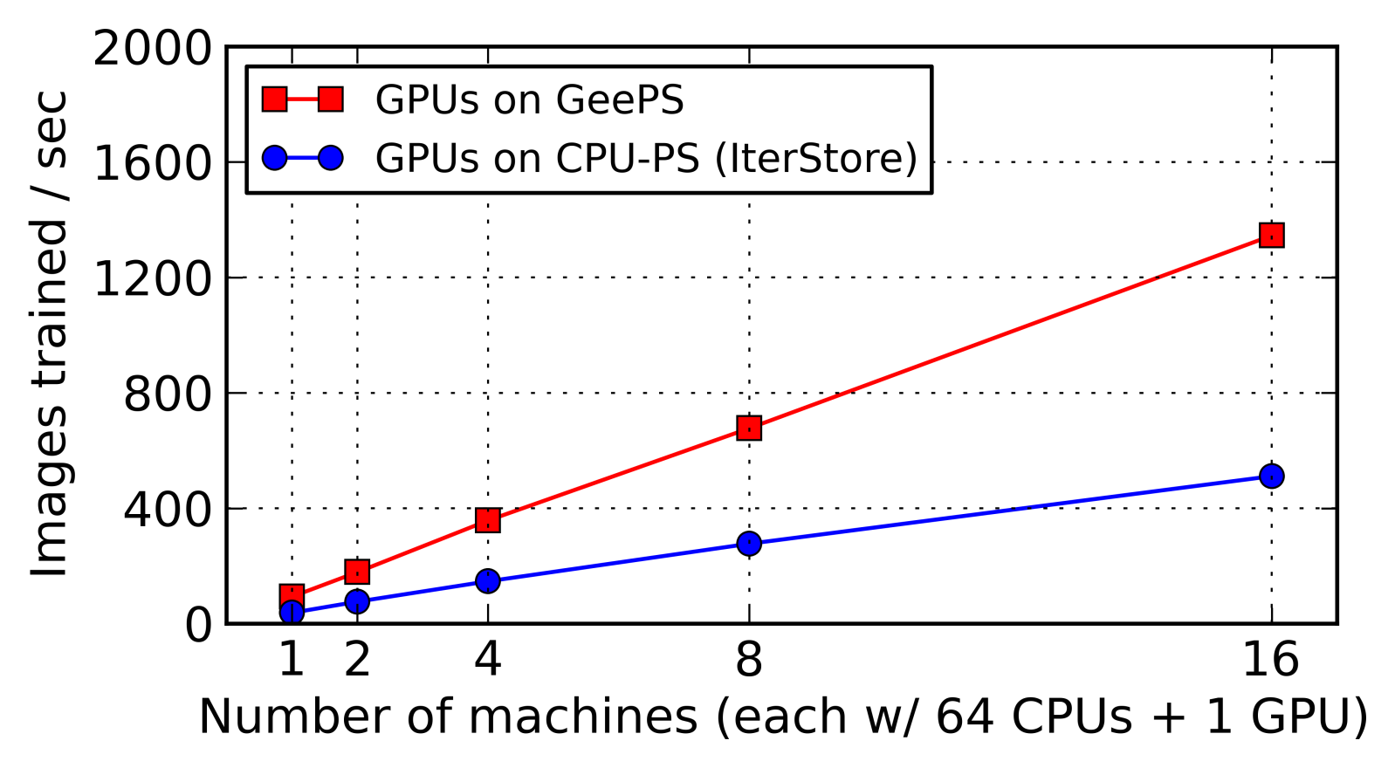
Training throughput
GeePS is much faster than CPU-based PS
2.6x higher throughput
Notes:
The first graph shows the training throughput scalability. The Y axis is the training throughput, higher is better, and the X axis is the number of machines we use.
We first compare GeePS with IterStore. Both the GeePS setup and the IterStore setup use Caffe to do machine learning computations with GPUs. But for the IterStore setup, each time the application accesses the parameter data, they will have to do the CPU/GPU data transfer in the foreground. Because of this overhead, the IterStore setup is 2 and a half times slower than GeePS.

Slide 38
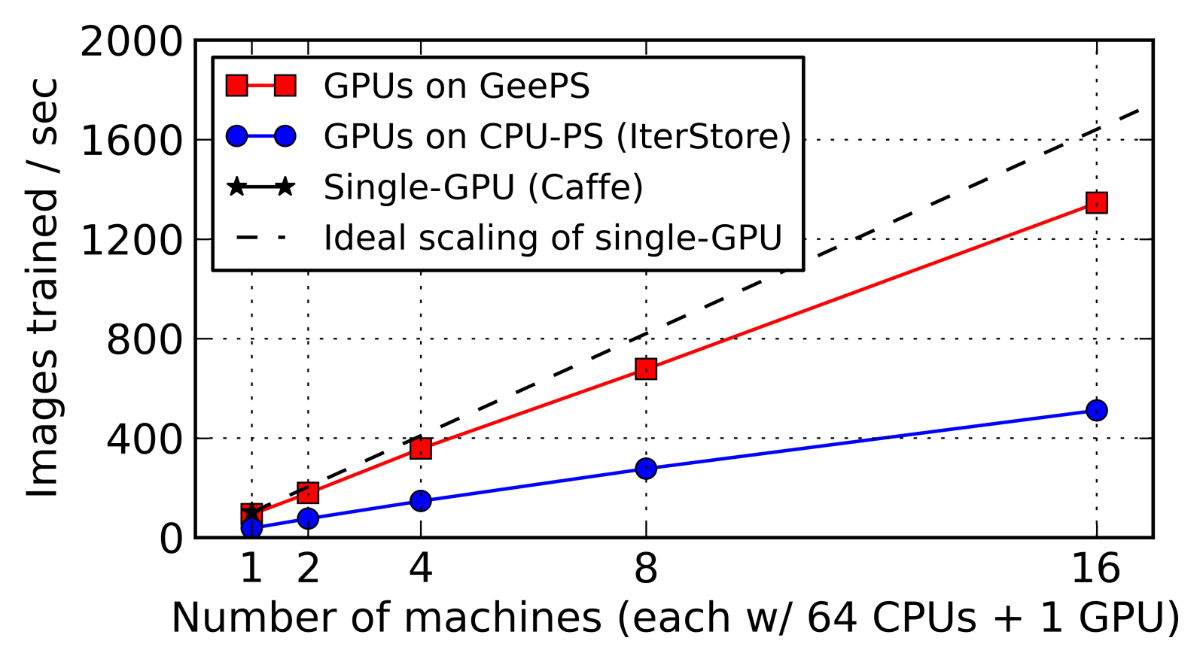
Training throughput
Single-GPU
GeePS scales close to linear with more machines
with 16 machines, 13x faster than single-GPU
Notes:
We also compare GeePS with the ideal scalability of Caffe, which is this dashed line. We can see that GeePS scales relatively close to ideal. With 16 machines, GeePS runs the same workload 13 times faster than single-machine Caffe.

Slide 39
Take-away messages from GeePS
GPU-specialized parameter server for GPU DL
exploits the layer-by-layer pattern
efficiently overlap data transfer with computation
13x throughput speedup using 16 machines
efficiently handle problems larger than GPU memory
Notes:
To summarize the GeePS work, we designed a parameter server for GPU deep learning.
It exploits the layer-by-layer pattern of deep learning computation, so that it can efficiently overlap data transfer with the computation.

Slide 40
Three case studies
IterStore [Cui et al. SoCC ‘14]
an efficient parameter server design
exploits repeated parameter data access
GeePS [Cui et al. EuroSys ‘16]
specialized parameter server for GPU deep learning
exploits layer-by-layer pattern of deep learning
MLtuner [In preparation]
system for automatic machine learning tuning
exploits quick decision of training hyperparam tuning
Notes:
The third piece of work is MLtuner, it’s a system for automatic machine learning tuning.

Slide 41




Training tunables in machine learning
Training tunables:
learning rate (step size)
momentum
training batch size
data staleness bound
...
Tuning them is important
affect task completion time
affect solution quality
Notes:
Training a machine learning model often requires the selection and tuning of many training hyperparameters, such as the learning rate, momentum, training batch size, and data staleness bound.
In this work, in order to emphasize that those hyperparameters can be tuned and should be tuned, we call them training tunables in this work.
It is important to tune those tunables, because people find the selection of those training tunables can greatly affect the completion time of the machine learning tasks. And moreover, people also find the selection of the training tunables can even affect the quality of the converged model.

Slide 42
Training tunables in machine learning
Training tunables:
learning rate (step size)
momentum
training batch size
data staleness bound
...
Model hyperparams:
network depth
neuron layer sizes
neuron activation function
...
In the obj. function
NOT in the obj. function
Notes:
Before we move on, it is important to distinguish our training tunables, from another class of hyperparameters, called model hyperparameters.
Our training tunables only control the training procedure, but they do not change the model. The model hyperparameters, on the other hand, they define the model and appear in the objective function.
(HIT) In this work, we focus on tuning only the training tunables, and we do not change the model hyperparameters.

Slide 43
Traditional tuning approaches
Manual tuning
by domain expert, via trial and error
slow, expensive and prone to sub-optimal settings
Automatic hyperparam tuning approaches
e.g., Spearmint [Snoek et al. ‘12] and HyperBand [Li et al. ‘16]
designed for model hyperparameter tuning
need to train models to completion multiple times
high overhead
cannot change tunables during training
fail to achieve good model quality for many apps
MLtuner will address those problems
Notes:
There are several traditional tuning approaches.
The first and the most common approach is manual tuning.
Obviously, doing that manually is very inefficient and prone to sub-optimal settings.
There are some existing automatic tuning approaches, such as Spearmint and HyperBand. However, those approaches are actually designed for tuning the model hyperparameters. Because of that, they often need to train the models to completion multiple times, with different hyperparameter settings, in order to pick the best model. Because of that, their overhead is very high.
(HIT) Moreover, none of the existing approaches can dynamically change the tunablable during the training. But people find that for many deep learning applications, we actually need to change the learning rate during the training, in order to achieve good model accuracies. So those approaches fail to achieve good model accuracies for those deep learning applications.
Our MLtuner system will address those problems. It has much lower overhead, and can re-tune the tunables during the training.

Slide 44





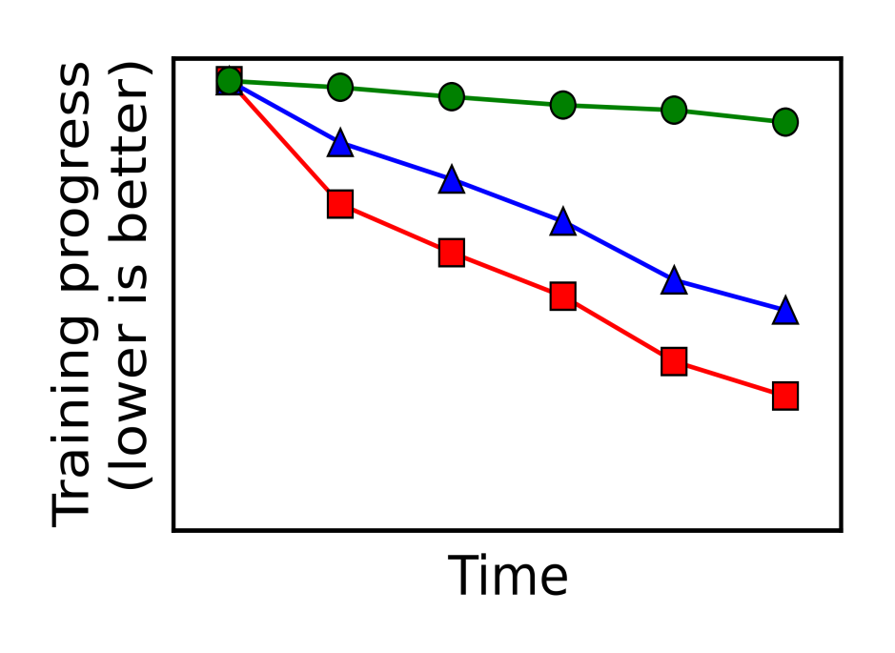

Try & evaluate tunables in trial branches
Tunable setting #1
Each running for some time
Tunable setting #2
Starting branch
Tunable setting #3
Monitor convergence speed
Forked trial training branches
Notes:
The basic idea behind MLtuner is that it will try and evaluate the tunable settings efficiently with trial branches.
For example, when we want to tune the tunable setting for this image classification task. MLtuner will fork multiple training branches from the initial state. Those training branches all start from exactly the same state, but they use different tunable settings.
(HIT) We will run each of the training branches for some amount of trial time, and monitor their convergence speed. In this graph, the Y-axis is the training loss, and we cann see that all the branches start from the same training loss, but they have different convergence speed, because they use different tunable settings.
Then, we pick the branch with the fastest convergence speed,

Slide 45
Try & evaluate tunables in trial branches
Tunable setting #1
Tunable setting #2
Tunable setting #3
Keep training only the best branch
Notes:
and keep running only the best branch.
The design exploits the fact that the best tunable setting can often be decided pretty quickly with a small amount of trial time, and we don’t actually need to run each of the settings to completion.

Slide 46
Re-tuning tunables
Tunable setting #4
Tunable setting #3
Tunable setting #5
Re-tune because best setting changes
Many deep learning apps require re-tuning learning rate to achieve good model quality
Tunable setting #3
Notes:
MLtuner will also re-tune the tunables during the training, because we find the best tunable setting often changes during the training. Moreover, re-tuning is necessary for many deep learning applications to achieve good model accuracies.
MLtuner re-tunes the tunables with a similar way as the tuning procedure. Suppose we have been running this branch for a while, and want to re-tune the tunables. We it just fork some trial branches, from the trained branch, (HIT) and pick the branch with the fastest convergence speed, and keep training only the best branch.

Slide 47
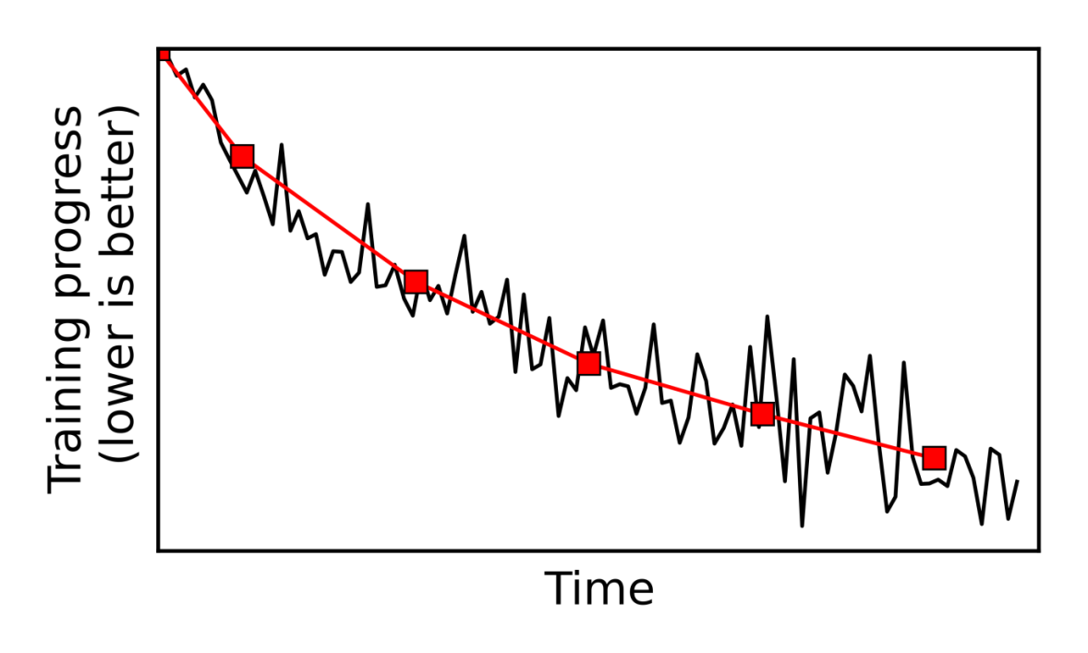
MLtuner design details
Pick settings to try with HyperOpt algorithm
Monitor training loss to estimate speed
Downsample the noisy loss traces
Decide the trial time based on noisiness
Notes:
Next, I’m going to briefly talk about some of the design details of MLtuner.
MLtuner picks the tunable settings to try with the HyperOpt algorithm. HyperOpt is a popular optimization algorithm that many previous work used to sample the tunable settings from the search space.
MLtuner will monitor the training loss to estimate the convergence speed. Also, because the actual training loss is usually quite noisy, MLtuner will downsample the training loss, and estimate the convergence speed from the downsampled loss trace.
MLtuner will also automatically decide how much trial time it should try the tunable settings, based on the noisiness of the training loss. This part is more interesting, and I will talk more about that.

Slide 48
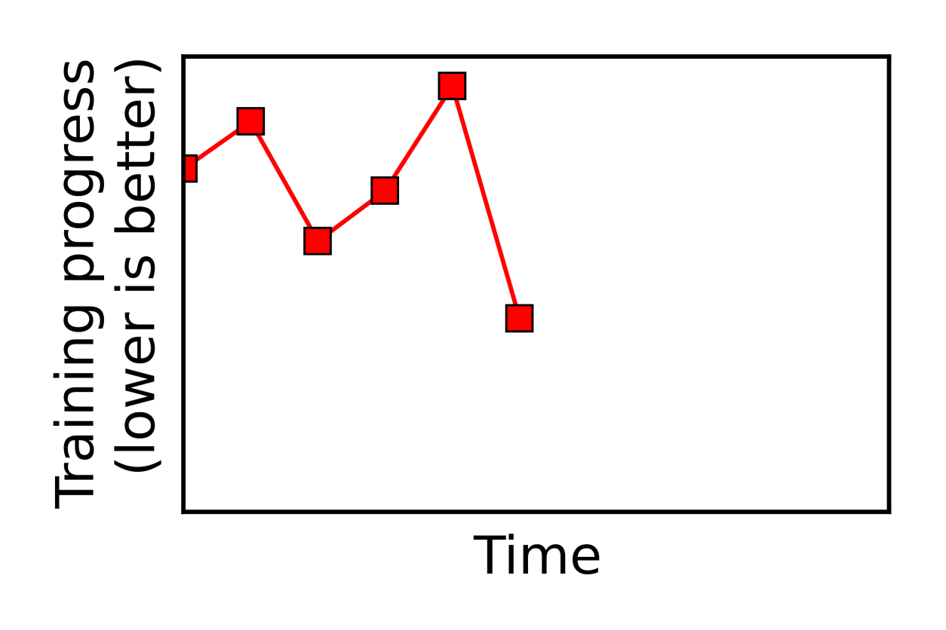
Deciding trial time based on stability
Progress not stable
Start with minimal trial time
Check the stability of converging progress
Notes:
To decide the trial time, MLtuner will first start with a minimal trial time, and run the branches with the trial time.
And MLtuner will check the stability of the converging progress of the branches. Here, in this example, because the current trial time is too short, this training progress is unstable.
If none of the branches that MLtuner has tried so far has stable converging progress,

Slide 49
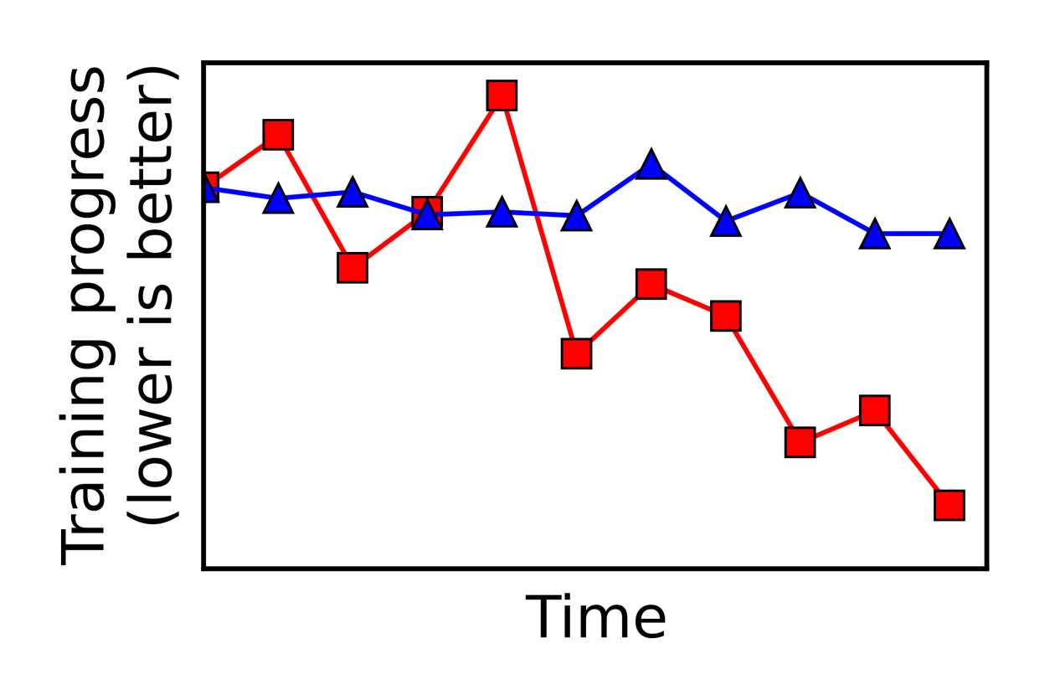
Deciding trial time based on stability
Trial time doubled
Start with minimal trial time
Check the stability of converging progress
Double trial time, until any stable branch found
Use the decided trial time for all future branches
Notes:
MLtuner will double the trial time, and use the doubled trial time to run the future branches, and it will also run all the previous branches for longer, with the new trial time.
MLtuner will keep doubling the trial time, until it finds at least one branch that has a stable converging progress. That is how the trial time is decided.

Slide 50
Experimental setups
Application: image classification
model: Inception-BN
dataset: ILSVRC12
other apps include RNNs and matrix factorization
Tunables:
learning rate, momentum, batch size, data staleness
Baselines
Spearmint [Snoek et al. ‘12]
HyperBand [Li et al. ‘16]
Notes:
Next, I will show you some highlights of our MLtuner results here. I’m only going to show you the results on the image classification benchmark, but we have good results on video classification with RNNs and matrix factorization as well.
For this set of experiments, we will tune the learning rate, momentum, batch size, and data staleness bound.
We will compare our MLtuner system with two baseline approaches. The Spearmint approach and the HyperBand approach.

Slide 51
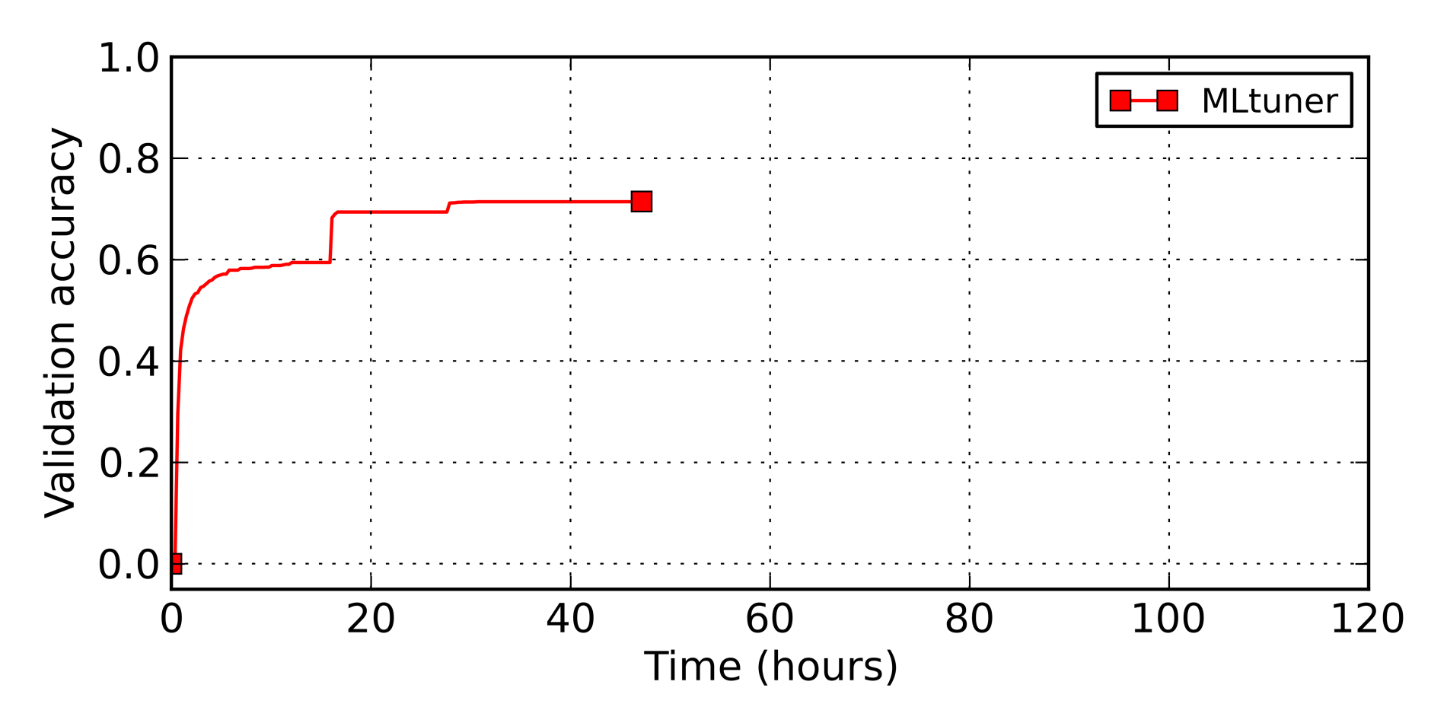
MLtuner vs. traditional tuning approaches
Benchmark: image classification with Inception-BN on ILSVRC12
Tunables: learning rate, momentum, batch size, data staleness
Re-tuning improves model accuracy
Notes:
We are interested in both the total run time and the achieve classification accuracy for this benchmark. The X-axis is the time, in hours, and the Y-axis is the validation accuracy.
The red curve is the result of MLtuner. Here, even though this graph shows the model accuracy as the Y-axis, MLtuner actually tunes the tunable settings based on the training loss, which can be collected more frequently than the model accuracies.

Slide 52
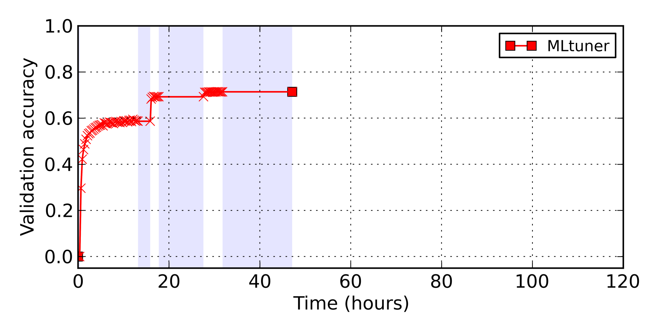
MLtuner vs. traditional tuning approaches
Benchmark: image classification with Inception-BN on ILSVRC12
Tunables: learning rate, momentum, batch size, data staleness
MLtuner tunes tunables
(based on training loss)
Re-tuning improves model accuracy
Notes:
To better understand the behavior of MLtuner, we mark the actual training work with the markers, and use the shaded area to represent the tuning part.
MLtuner tunes the tunables at the beginning of the training, and also re-tunes tunables, when the model accuracy stops increasing. We can see from the graph that after the re-tunings, the model accuracies are improved. This behavior is consistent with what the other people have found that when training a deep neural network, we need to change the learning rate during the training. So re-tuning is necessary.

Slide 53
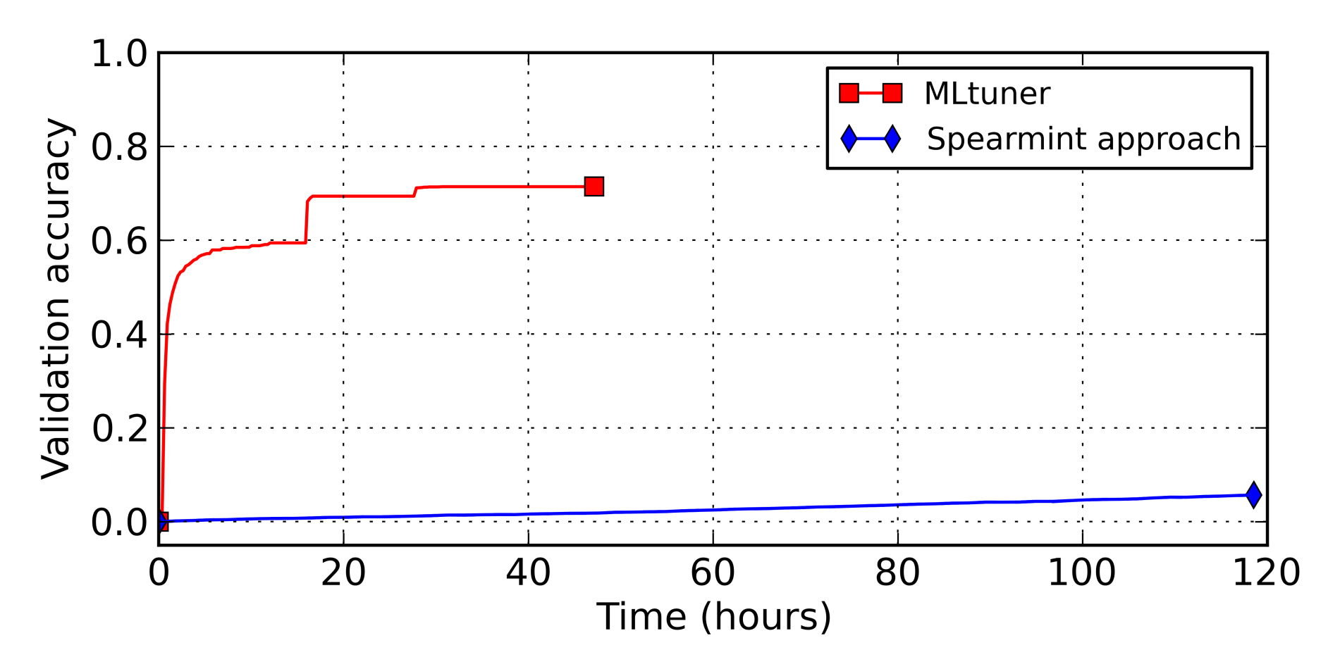
MLtuner vs. traditional tuning approaches
Benchmark: image classification with Inception-BN on ILSVRC12
Tunables: learning rate, momentum, batch size, data staleness
Not finished yet
Spearmint approach:
sample settings with Bayesian optimization
run each sampled setting to completion
spent all time trying setting (lr=1e-5, m=0, bs=2, ds=0)
Notes:
The blue curve is the result of Spearmint. In the Spearmint approach, they sample the tunable settings with Bayesian optimization, and for each of the sampled settings, they will train the model with that setting to completion, and measure the model accuracy.
When we run the Spearmint approach, we find their Bayesian optimization algorithm first tries the setting with all tunables set to the minimum value, which is a very small learning rate and very small batch size. This setting caused the model to converge at a very slow rate. And because Spearmint runs all settings to completion, it spent all five days running only the first setting.

Slide 54
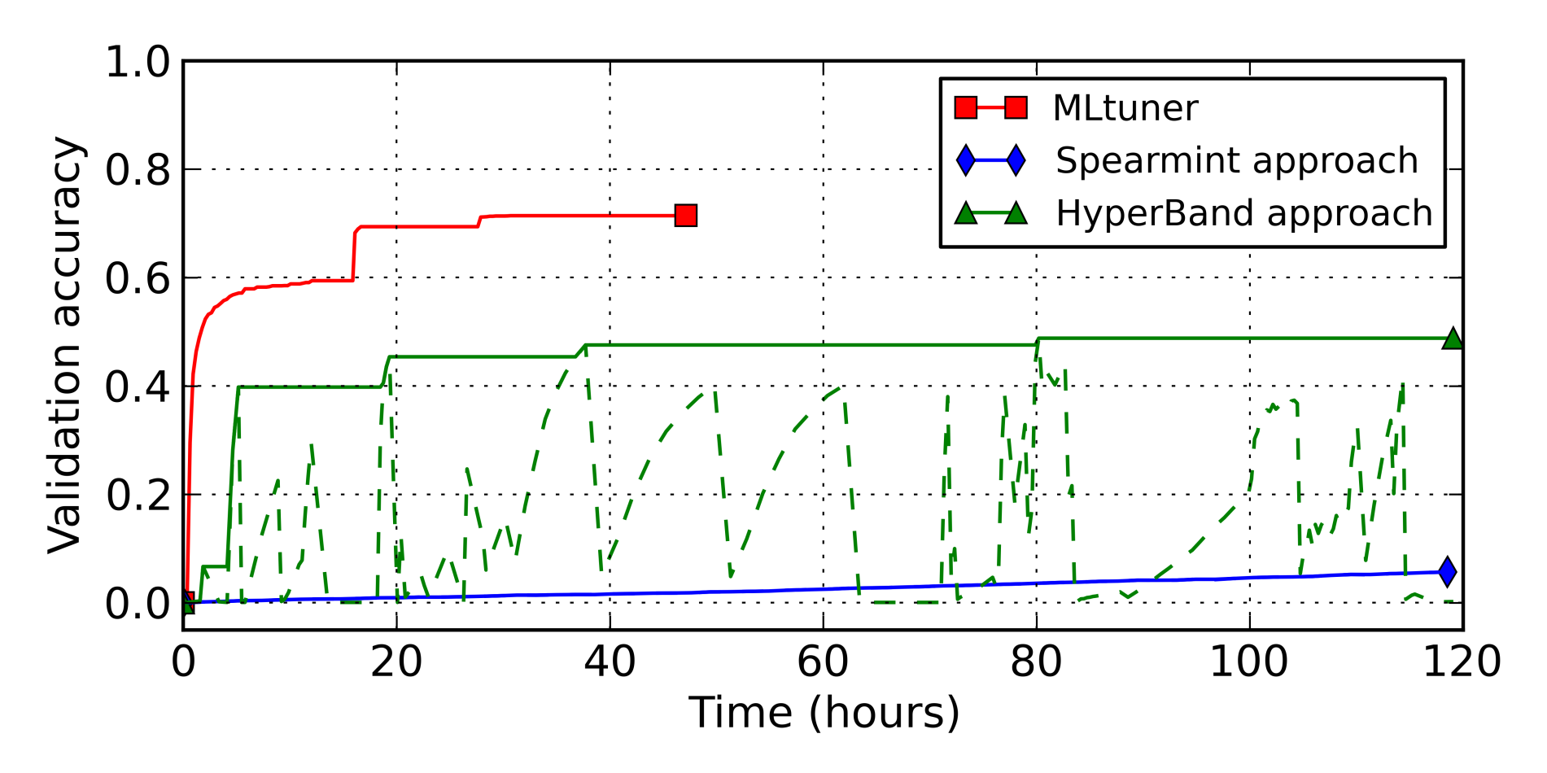
MLtuner vs. traditional tuning approaches
Benchmark: image classification with Inception-BN on ILSVRC12
Tunables: learning rate, momentum, batch size, data staleness
Not finished yet
HyperBand approach:
try multiple settings in parallel
stop half of the trying settings every a few iterations
MLtuner converges faster and reaches higher accuracy
Notes:
The green curves are the result of HyperBand. In the HyperBand approach, they try multiple settings in parallel, and every a few iterations, they will stop half of the settings early, based on their accuracies.
The dashed curve shows the accuracies of each settings being tried, and the bold curve shows the maximum accuracy achieved over time. We can see that there are more settings being tried at the same time, and many of them are stopped early. But the tuning still takes very long time to finish, and it has not finished after running for 5 days. Also their accuracy achieved in 5 days is still much lower than the accuracy that Mltuner got in one day.

Slide 55
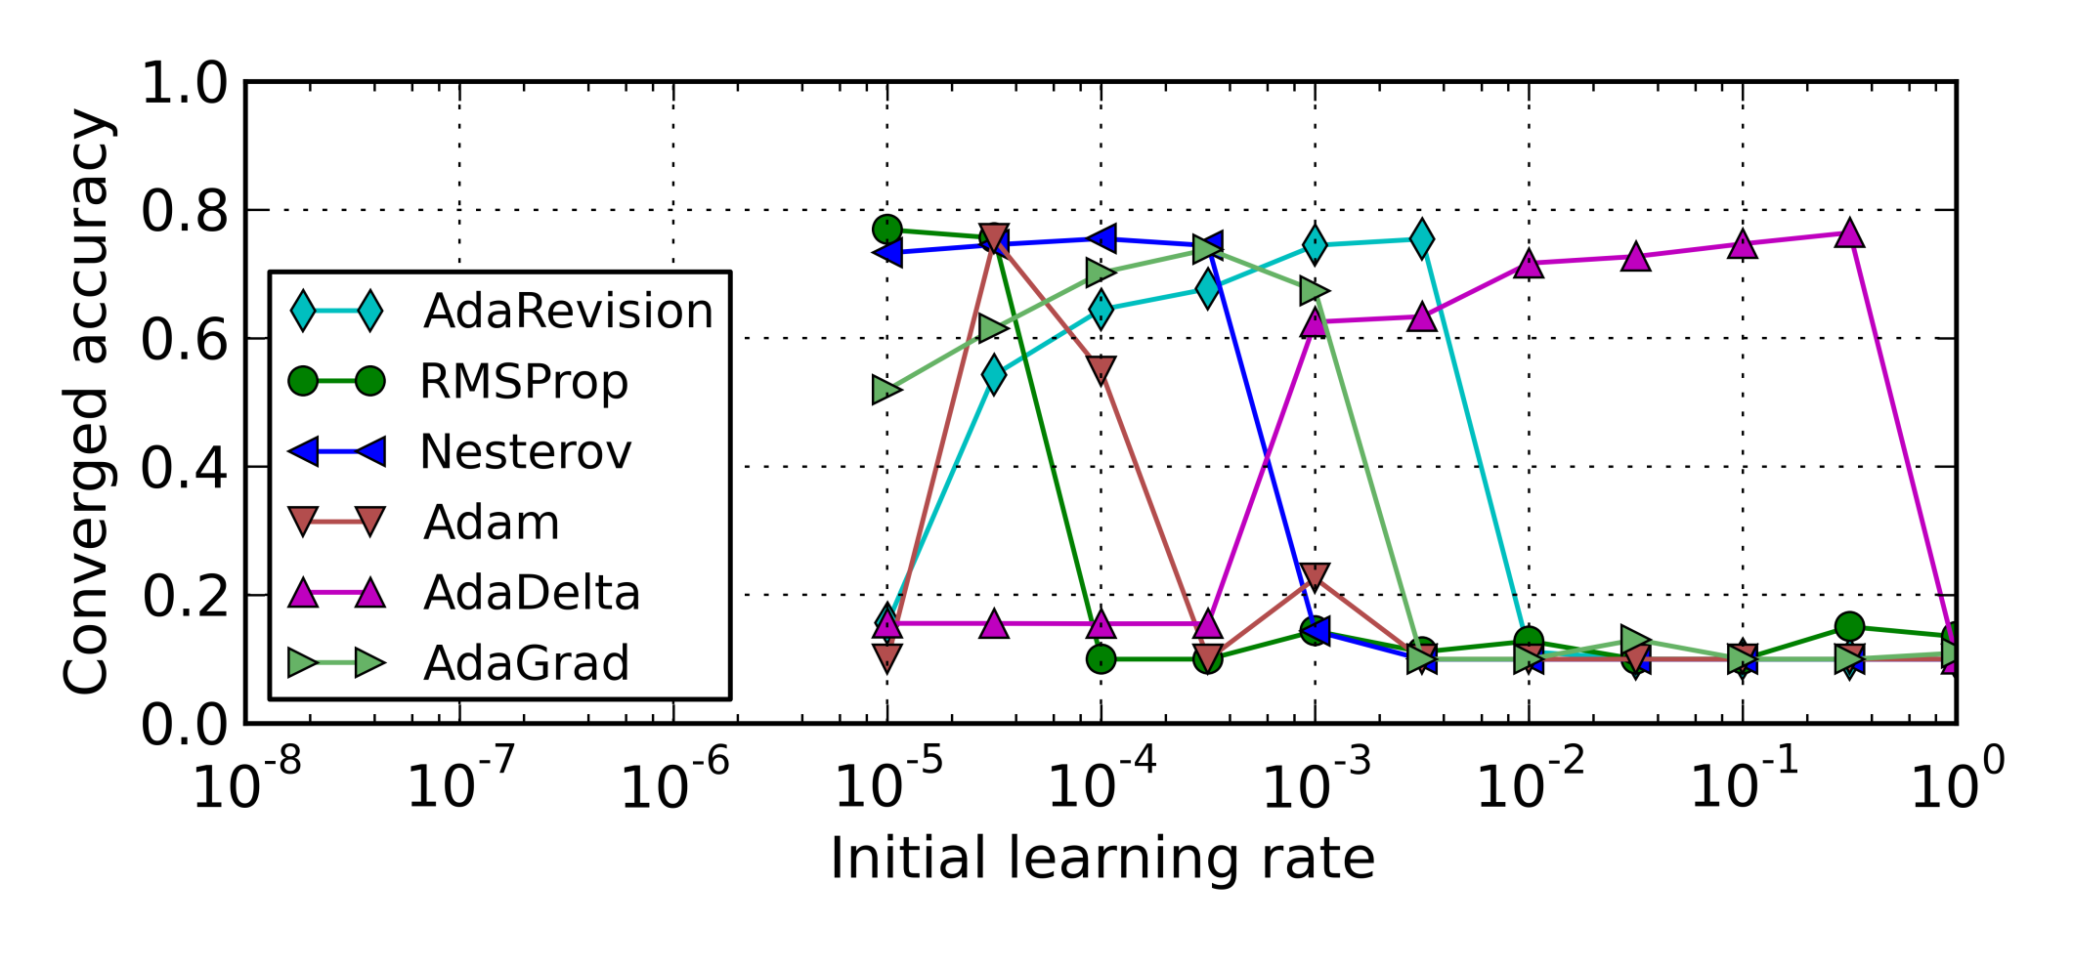
Tuning initial LR for adaptive LR algorithms
Benchmark: image classification with AlexNet on Cifar10
Initial learning rate affects converged model accuracies
Notes:
Sometimes people train SGD models with adaptive learning rate tuning algorithms, such as AdaRevision, RMSProp, and AdaGrad. Those algorithms can adaptively change the learning rate during the training. However, the users will still need to set their initial learning rates, and we find the initial learning rate setting actually matters. Here in this graph, the X-axis is the initial learning rate, and the Y-axis is the validation accuracy when the model is converged. We can see that, the optimal accuracy can only be achieved by one or two initial learning rate settings, and their optimal settings are all different.

Slide 56
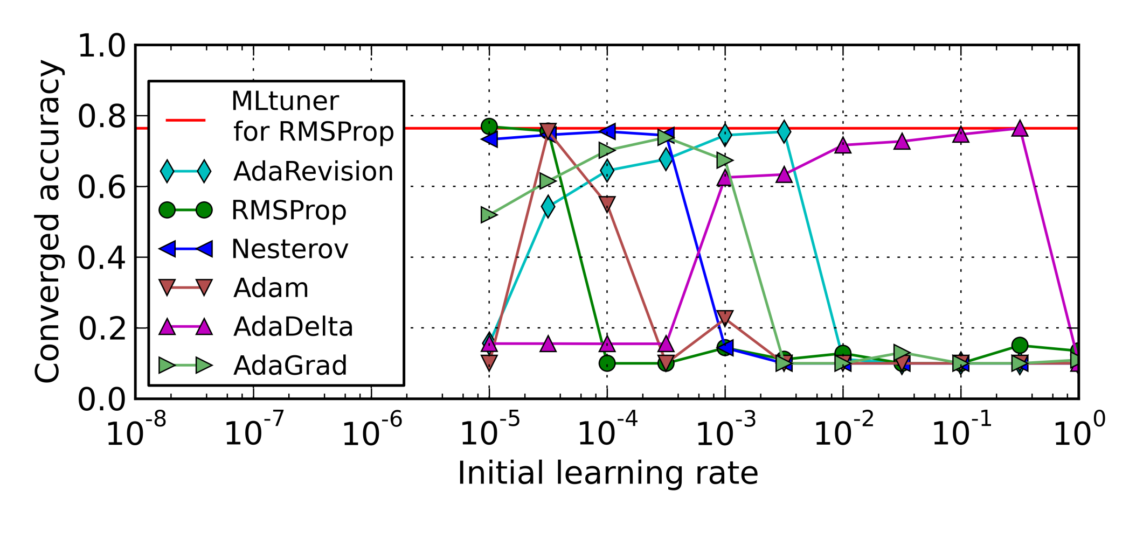
Tuning initial LR for adaptive LR algorithms
Benchmark: image classification with AlexNet on Cifar10
Tunable: initial learning rate
Initial learning rates picked by MLtuner are close to optimal
MLtuner complements the adaptive LR algorithms
Notes:
We can actually use MLtuner to pick the initial learning rate for those adaptive learning rate algorithms. The red line shows the accuracy when we pick the initial learning rate with MLtuner for the RMSProp algorithm. We get close to the ideal accuracy. For the other five algorithms, we also have similar results. The accuracies we get is within 1% different from the optimal accuracy. So our MLtuner approach actually complements the adaptive learning rate tuning algorithms, and robustly find good settings for them.

Slide 57
Thesis contributions
IterStore [Cui et al. SoCC ‘14]
exploited repeated data access
designed methods of determining it and specializations to exploit it
up to 50x speed up
GeePS [Cui et al. EuroSys ‘16]
exploited layer-by-layer pattern of deep learning
designed a PS that overlaps GPU/CPU data transfer with computation
2.5x speed up compared to traditional CPU parameter server
MLtuner [In preparation]
identified training tunables as a special class of hyperparams
over an order of magnitude faster than traditional tuning approaches
Notes:
Here are my thesis contributions.
In the IterStore work, we identified the repeated data access as an important characteristic of many machine learning applications. By exploiting this characteristic, we designed many parameter server optimizations that improve the performance by up to 50x.
In the GeePS work, we designed a parameter server that exploits the layer by layer pattern of the deep learning computation. It can efficiently overlap the GPU/CPU data transfer with the computation, and support large models that do not fit in GPU memory.
In the MLtuner work, we identified the training tunables as a special class of hyperparameters that can be tuned and re-tuned more efficiently. And we designed the MLtuner approach for tuning the training tunables, and is an order of magnitude faster than the traditional tuning approaches.

Slide 58
Thank you!
My wife
My advisor: Greg Ganger
My thesis committee
Phil Gibbons, Garth Gibson, Eric Xing, Derek Murray
My collaborators and colleagues at PDL
Jason Boles, Jim Cipar, Chuck Cranor, David Dai, Joan Digney, Chad Dougherty, Zis Economou, Mitch Franzos, Aaron Harlap, Qirong Ho, Kevin Hsieh, Angela Jiang, Rajat Kateja, Kim Keeton, Jin Kyu Kim, Karen Lindenfelser, Hyeontaek Lim, Jun Woo Park, Aurick Qiao, Indrajit Roy, Alexey Tumanov, Jinliang Wei, Pengtao Xie, Lianghong Xu, Xiaolin Zang, Hao Zhang
Notes:
At the end of the talk, I want to thank everyone that have helped me during my PhD study.
I want to thank my wife, my advisor Greg, my thesis committee, Phil, Garth, Eric, and Derek. And I want to thank all my collaborators and colleagues. Thank you for your help and support and without you it’s impossible for me to get there.
Thank you!

Slide 59
References
[IterStore] H. Cui, A. Tumanov, J. Wei, L. Xu, W. Dai, J. Haber-Kucharsky, Q. Ho, G. R. Ganger, P. B. Gibbons, G. A. Gibson, and E. P. Xing. Exploiting iterative-ness for parallel ML computations. In SoCC, 2014.
[GeePS] H. Cui, H. Zhang, G. R. Ganger, P. B. Gibbons, and E. P. Xing. GeePS: Scalable deep learning on distributed GPUs with a GPU-specialized parameter server. In EuroSys, 2016.
[LazyTable] H. Cui, J. Cipar, Q. Ho, J. K. Kim, S. Lee, A. Kumar, J. Wei, W. Dai, G. R. Ganger, P. B. Gibbons, G. A. Gibson, and E. P. Xing. Exploiting bounded staleness to speed up big data analytics. In ATC, 2014.
[Aperture] H. Cui, K. Keeton, I. Roy, K. Viswanathan, and G. R. Ganger. Using data transformations for low-latency time series analysis. In SoCC, 2015.

Slide 60
References
[SSP] Q. Ho, J. Cipar, H. Cui, S. Lee, J. K. Kim, P. B. Gibbons,G. A. Gibson, G. R. Ganger, and E. P. Xing. More effective distributed ML via a Stale Synchronous Parallel parameter server. In NIPS, 2013.
[GraphLab] J. Gonzalez, Y. Low, et al. PowerGraph: Distributed graph-parallel computation on natural graphs. In OSDI, 2012.
[Caffe] Y. Jia, et al. Caffe: Convolutional architecture for fast feature embedding. arXiv preprint arXiv:1408.5093, 2014.
[Spearmint] J. Snoek, et al. Practical bayesian optimization of machine learning algorithms. In NIPS, 2012.
[HyperBand] L. Li, et al. Hyperband: A Novel Bandit-Based Approach to Hyperparameter Optimization. arXiv preprint arXiv:1603.06560v3, 2016.

Slide 61
Additional related work
M. Li, et al. Scaling distributed machine learning with the parameter server. In OSDI, 2014.
T. Chilimbi, et al. Project Adam: Building an efficient and scalable deep learning training system. In OSDI, 2014.
T. Chen, et al. MXNet: A flexible and efficient machine learning library for heterogeneous distributed systems. arXiv preprint arXiv:1512.01274, 2015.
J. Dean, et al. Large scale distributed deep networks. In NIPS, 2012.
E. R. Sparks, et al. Automating Model Search for Large Scale Machine Learning. In SoCC, 2015

Slide 62
BACKUP SLIDES

Slide 63
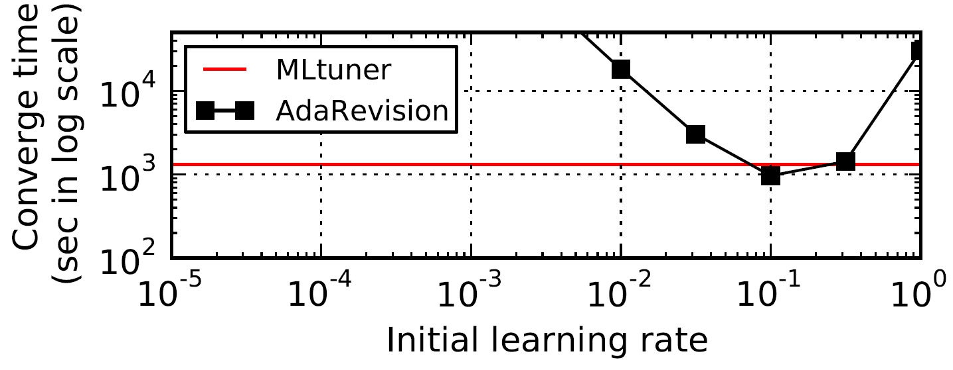
Tuning initial LR improves convergence time
Benchmark: matrix factorization

Slide 64
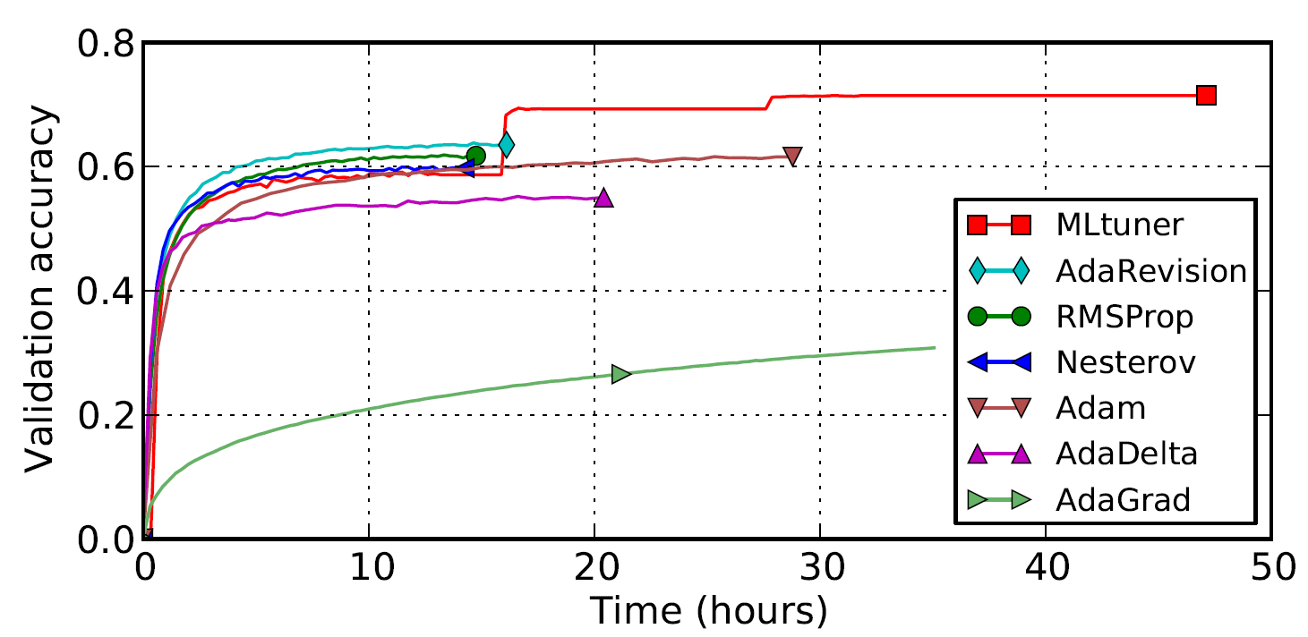
MLtuner vs. adaptive LR algorithms
Benchmark: image classification with Inception-BN on ILSVRC12
Tunables: learning rate, momentum, batch size, data staleness

Slide 65
Interface to GeePS-managed buffer
Read
Buffer “allocated” by GeePS
Data copied to buffer
PostRead
Buffer reclaimed
PreUpdate
Buffer “allocated” by GeePS
Update
Updates applied to data
Buffer reclaimed
Notes:
Here is the list of our interfaces to the GeePS managed buffers. I just talked about reads. Post-read is for after the application finishes using the read buffer, it will call post-read to release the buffer.
Similarly, when the application updates data, it first request a buffer by calling pre-update. And when it has the updates ready in the buffer, it calls update, and GeePS will apply the updates and reclaim the buffer.

Slide 66
Highlights of memory management results
Handle problems larger than GPU memory
Only 27% reduction in throughput with 35% memory
3x bigger problems with little overhead
Handle models as large as 20 GB with 5 GB GPUs
prior data-parallel ML is limited to <5 GB models
Support 4x longer videos for video classification
Notes:
Here are some highlights of our GPU memory management results. With the memory management design, we can handle three times larger problems without much overhead, and we can train neural networks with up to 20 gigabytes of model parameters with only 5 gigabyte GPUs.

Slide 67
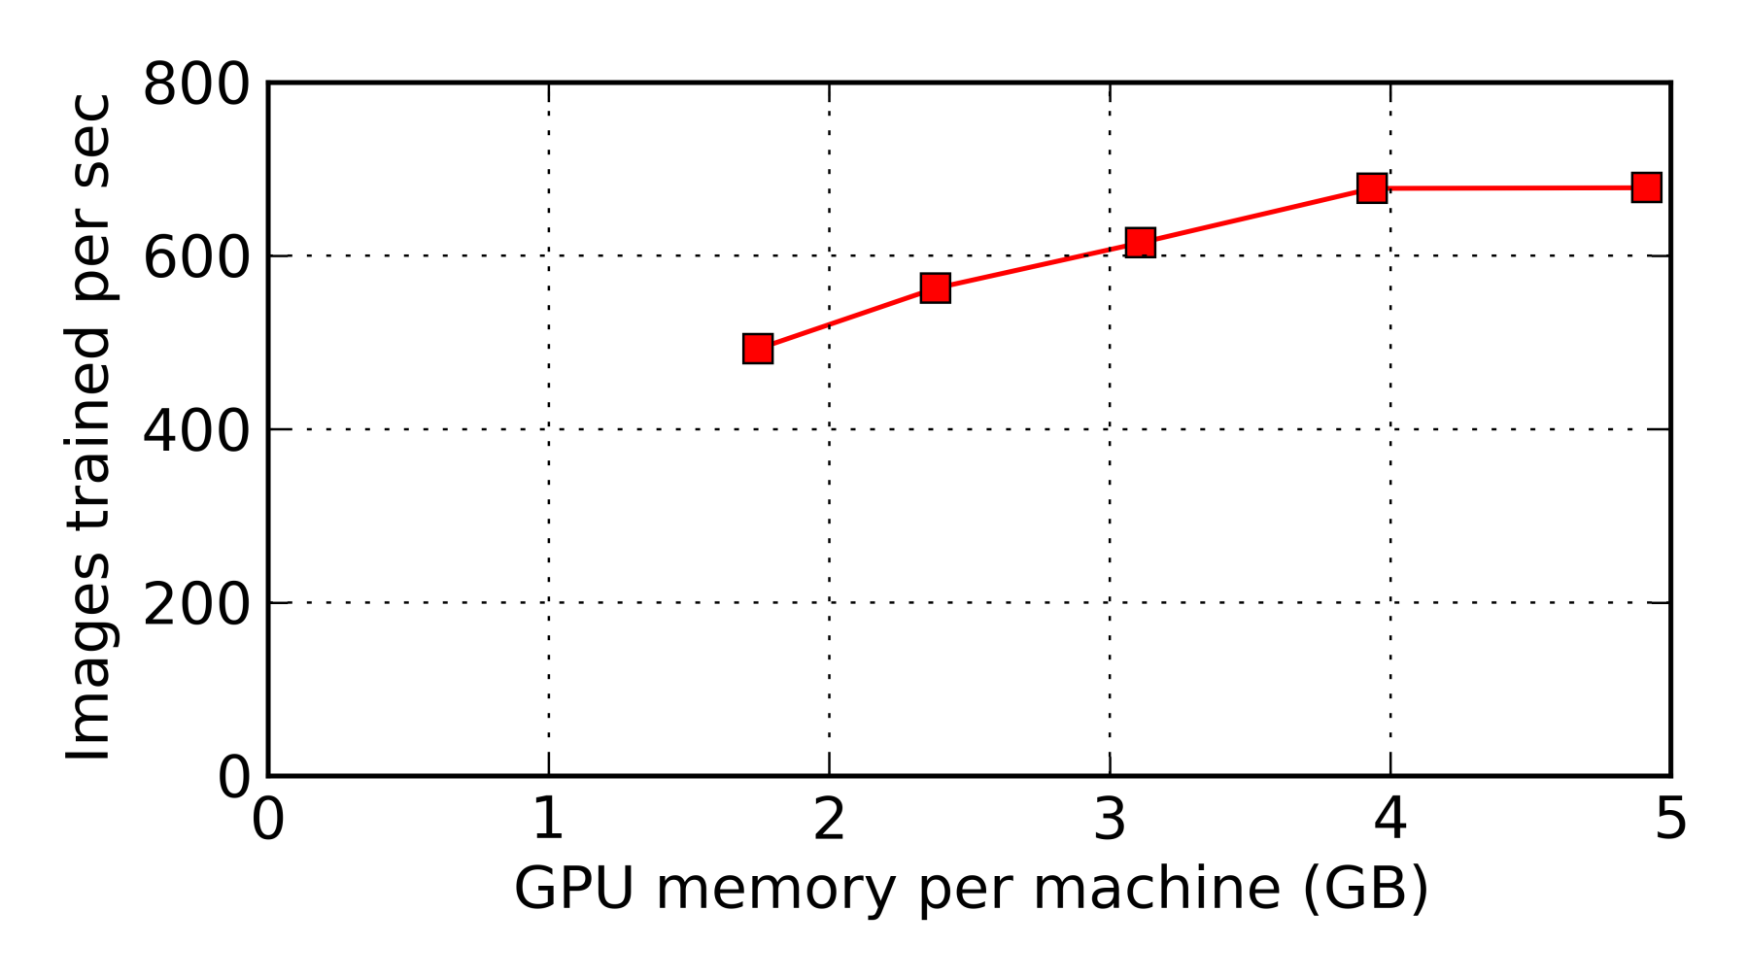
Throughput vs. memory budget
All data fits in GPU memory
Just enough GPU memory
for double buffering
Only 27% reduction in throughput with 35% memory
means 3x bigger problems without much overhead
Notes:
In this second set of experiments, we measure the training throughput of GeePS when we assign different amount of GPU memory for GeePS to use. Here the Y axis is the training throughput, the higher is better, and the X axis is the GPU memory we assigned to GeePS. The rightmost point is the case where everything fits in GPU memory. The leftmost point is the case where the GPU memory is just enough for double buffering the largest layer.
Comparing these two points, we have only 27% reduction in training throughput when we use only one third of the GPU memory.
This result means that GeePS can train neural networks that do not fit in GPU memory with small overhead.

Slide 68
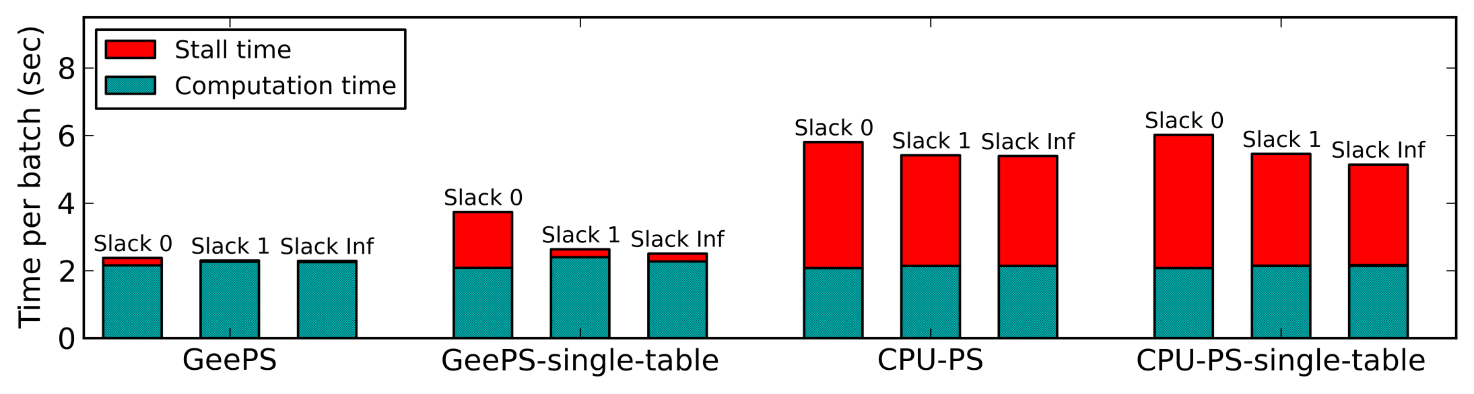
Computation vs. stall times (more)
GeePS and CPU-PS: updates of each layer are sent in distinct batches
Single-table: updates of all layers are sent in a single batch

Slide 69





MLtuner
Much lower overhead
Re-tunes tunables during the training
MLtuner
tunable setting
feedback
Training System
Notes:
Our MLtuner system is able to address those problems.
MLtuner is a system for automatically tuning the training tunables. It can be connected with existing training systems, such as the parameter servers. It has much lower overhead, and is able to re-tune the tunables during the training.

Slide 70
Time sharing for training branches
Branch #0 (parent)
Branch #1
Branch #2
Branch #3
...
Time
trial time
trial time
trial time
Notes:
The Mltuner system will schedule the execution of the training branches, in a time sharing manner.
Suppose we have a parent branch, branch zero. (HIT) we first fork a branch #1 from it, and run for some time, and measure its convergence speed. then fork a branch #2 from it, run for some time, measure its convergence speed, and fork a branch #3 from it, and run for some time, measure its convergence speed.

Slide 71
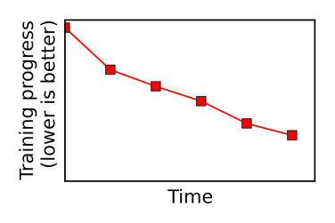
Tunabel searching loop
tunable choice to try
Searching
Logic
Tunable
Searcher
convergence speed
Fork a branch to try tunable for trial time
Progress
Summarizer
Tuning system
training progress
Training System
Notes:
I will first show you how we search the tunables.
(HIT) Inside the searching loop, we have a tunable searcher module that proposes tunable choices to try. And I will describe the tunable searcher in more details in later slides.
(HIT) We then send message to the training system, to let it fork a training branch to try this tunable choice, for some amount of time. I will tell you how we decide this trial time later.
(HIT) We will collect the training progress from the training system, which is timeseries data.
(HIT) We will use a progress summarizer module to summarize convergence speed from the training progress, and report the convergence speed to the tunable searcher. I will talk about the progress summarizer in later slides.
Next, I will talk about each of the components in this diagram, as I promised.

Slide 72

Summarizing progress
Slope of the training progress
(progress per second)
convergence speed
Progress
Summarizer
training progress
(e.g., obj. func. value)
Notes:
Next, I will show you how we measure the convergence speed. The training system will report its training progress to the tuning system. In our example applications, the training progress is essentially the current values of the objective function, and it is timeseries data.
(HIT) The most straight forward way of calculating the convergence speed is to take the slope of the training progress..

Slide 73
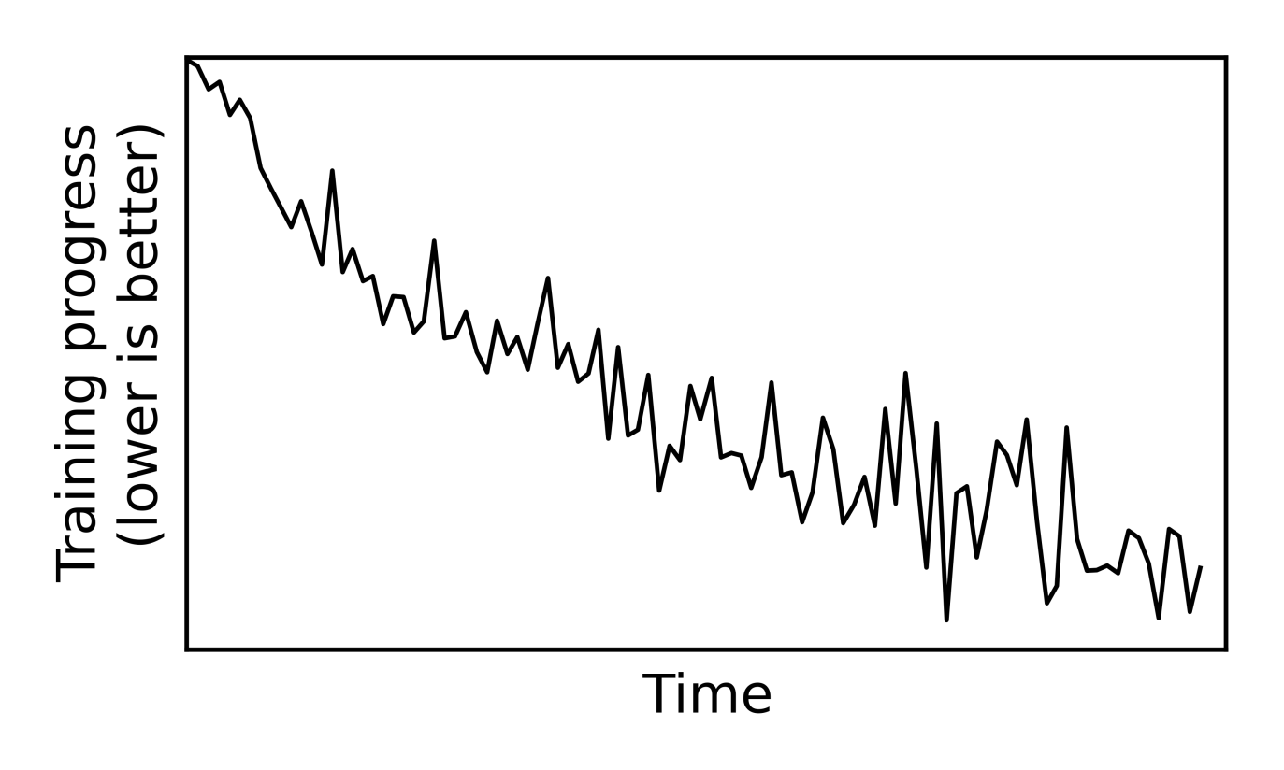
Summarizing progress
convergence speed
Progress
Summarizer
training progress
(e.g., obj. func. value)
Noisy progress
Notes:
However, in many applications, the training progress is very noisy. Directly using the slope between the first point and the last point might be problematic.

Slide 74
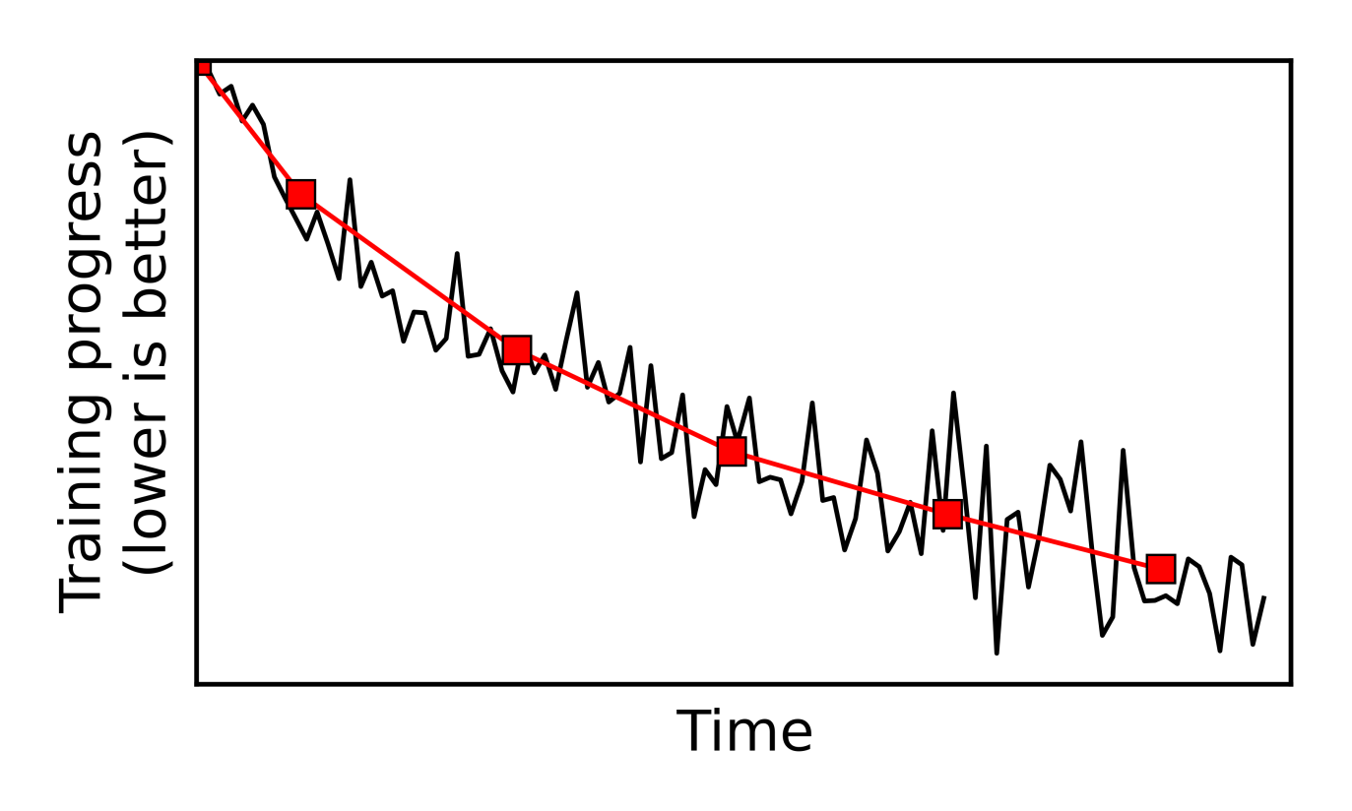
Summarizing progress
Slope of the downsampled progress
convergence speed
Progress
Summarizer
training progress
(e.g., obj. func. value)
Noisy progress
Notes:
Instead, our progress summarizer will downsample the training progress. We downsample it into fewer but smoother samples, and calculate the slope of the downsampled progress.

Slide 75
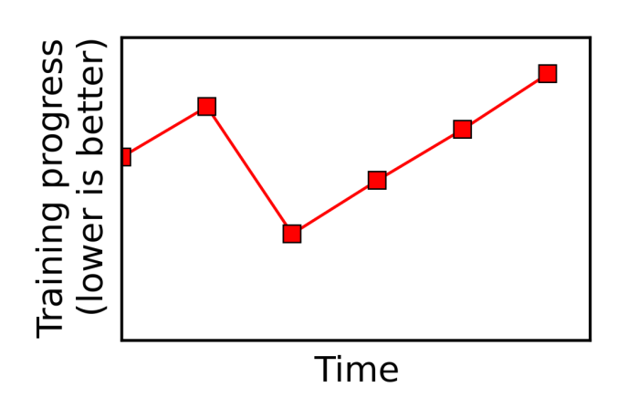
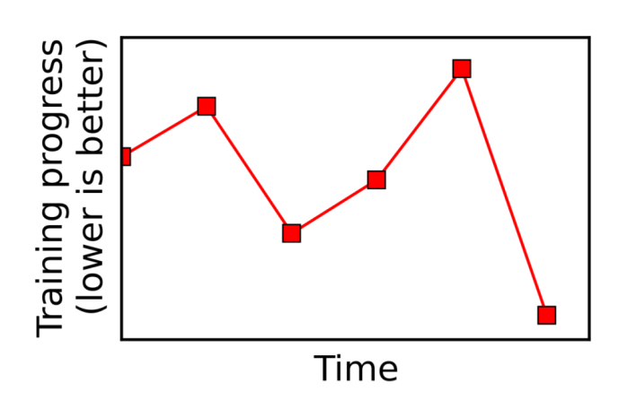
Summarizing progress
Convergence and stability checks
convergence speed
Slope cannot be positive
Progress cannot jump too much
Progress
Summarizer
training progress
(e.g., obj. func. value)
Not converging
(Might need to run for longer)
Notes:
Because the training progress is noisy, we cannot simply take the slope of every branch. We need to do some convergence and stability checks.
Assume that the training progress of a converging branch should be decreasing.
So, if the slope of a branch is positive, it’s going up, we will label this branch as not converging.
Moreover, even through, for this case, the last progress point is lower than the first point, the branch will also be labelled as not converging, because its progress is not stable enough. It jumps too much.
The not converging branches are not necessarily diverging. It might be because its progress is very noisy, and we haven’t run it for long enough to get stable progress.
So next, I will describe how we decide how long to run each branch, based on this information.

Slide 76
Deciding trial time
tunable choice to try
Searching
Logic
Try tunable for trial time
Need a long enough trial time to get stable progress
Notes:
Essentially we want a tunable trial time that is long enough for a good tunable choice to make stable converging progress.
We have designed a mechanism for automatically deciding the trial time.
We first initialize the tunable trial time to some small value, and we try the tunable choices, with this trial time. If we find none of the tunable choices converges, with the current trial time,

Slide 77
Deciding trial time
tunable choice to try
Searching
Logic
Try tunable for trial time
Need a long enough trial time to get stable progress
Double trial time until converging branch found
Notes:
we will double the trial time. Then, the next time we get a tunable choice from the searcher, we will try the new tunable choice, as well as all the previous ones, for longer, with the doubled trial time. We will keep doubling the trial time, until we a converging branch is found.

Slide 78
Stability condition
A converging progress (x_1, ..., x_n) is stable, iif
max(0, x_i – x_(i-1)) < (x_1 – x_n) / n
no jumps is more than 1/n of the whole range
Notes:
If none of the branches has stable converging progress, MLtuner will then double the trial time, and run the new branches and also the existing branches for longer.
MLtuner will keep doubling the trial time, until it finds any of the branches gets a stable converging progress. And it will use the decided trial time to try all future branches, and pick the branch that has the fastest convergence speed.

Slide 79
Tunable ranges
Learning rate
10^x, where x in [-5, 0]
Momentum
in [0.0, 1.0]
Batch size
in {2, 4, 8, 16, 32}
Data staleness
in {0, 1, 3, 7}

Slide 80
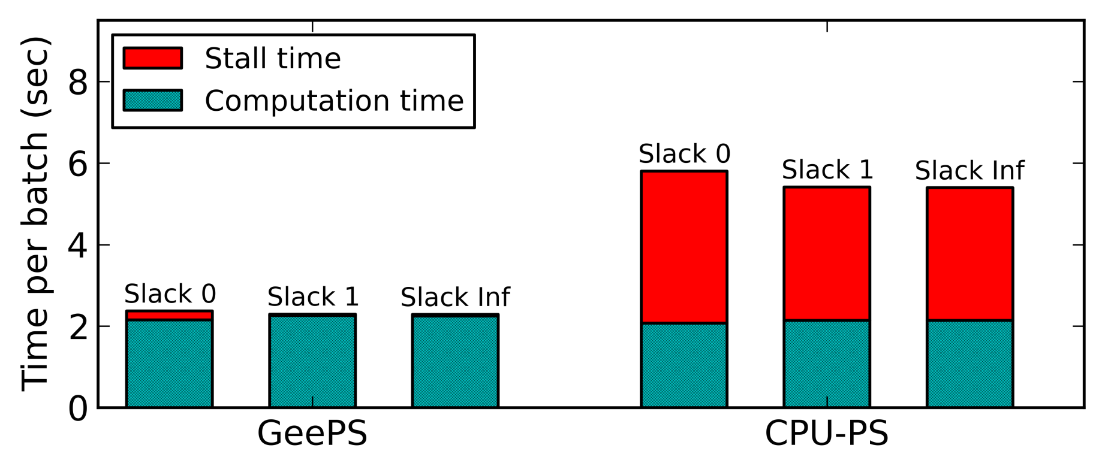
Computation vs. stall times
Even for slack 0, updates of a layer can be sent to other machines before the updates of other layers finish
CPU-PS has much overhead of transferring data between GPU/CPU memory in the foreground

Slide 81
More results in the paper
Good scalability and convergence speed for
GoogLeNet network
RNN network for video classification
Handle problems larger than GPU memory
Handle models as large as 20 GB with 5 GB GPUs
Support 4x longer videos for video classification
Notes:
There are more interesting results in the paper. For example, GeePS has good scalability and convergence speed for other networks such as GoogLeNet, and other problems, such as RNNs for video classification.
For GPU memory management, GeePS can train neural networks with up to 20 gigabytes of model parameters with only 5 gigabyte GPUs and support 4 times longer videos for video classification.

Slide 82
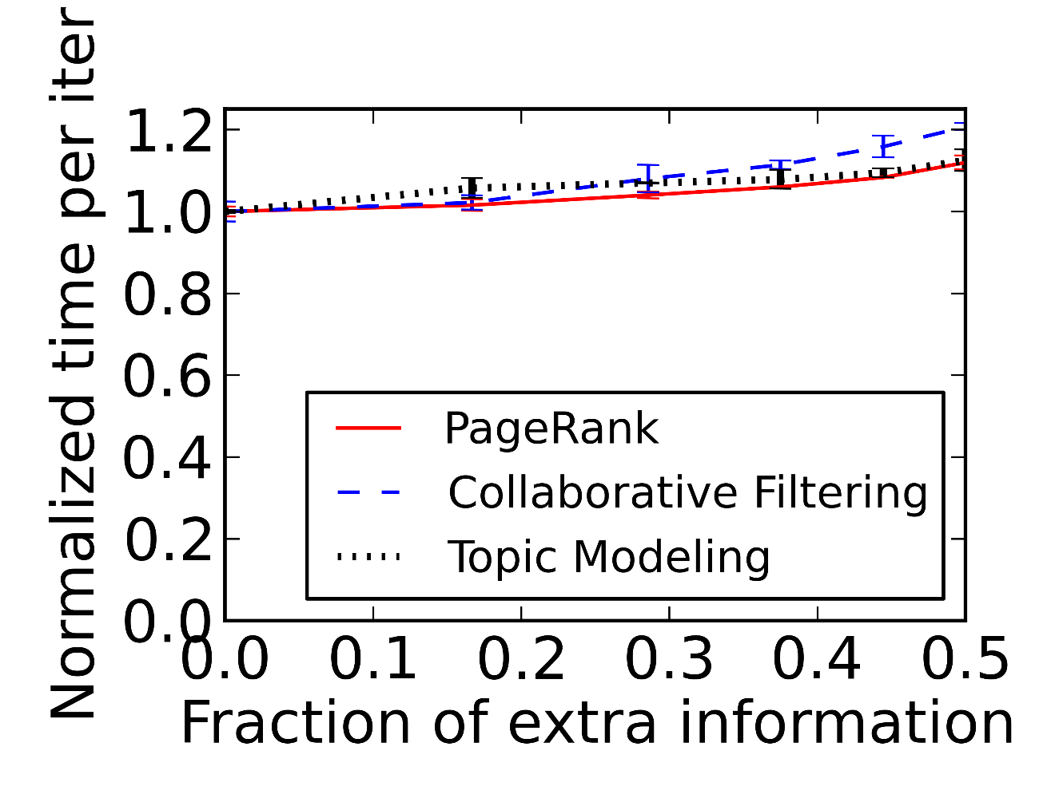
Sensitivity to information accuracy
Report more operations than performed
Can be caused by work migration or skipped work
All are insensitive to extra information
Notes:
In the first set of experiments, we have each worker report more operations than performed, and that can be caused by work migration or skipped work. The x axis is the fraction of extra reported operations. The y axis is the normalized timer per iteration, the ideal case is one. (HIT) With some extra information reported, the applications run only slightly slower, so they are insensitive to extra information. (That actually answers the question of how our approach works when some parameters already converge. There is almost no hurt if the reported information is more than performed. )

Slide 83
Sensitivity to information accuracy
Report less operations than performed
Can be caused by work migration
CF and TM are insensitive to missing information
Notes:
In the second set of experiments, we have each worker report less operations than real. That can only happen if we migrate work. The x axis is the fraction of unreported operations over all operations. The y axis is still the normalized timer per iteration. (HIT) For collaborative filtering and topic modeling, the slow down is tiny, meaning that they are insensitive to missing information.

Slide 84
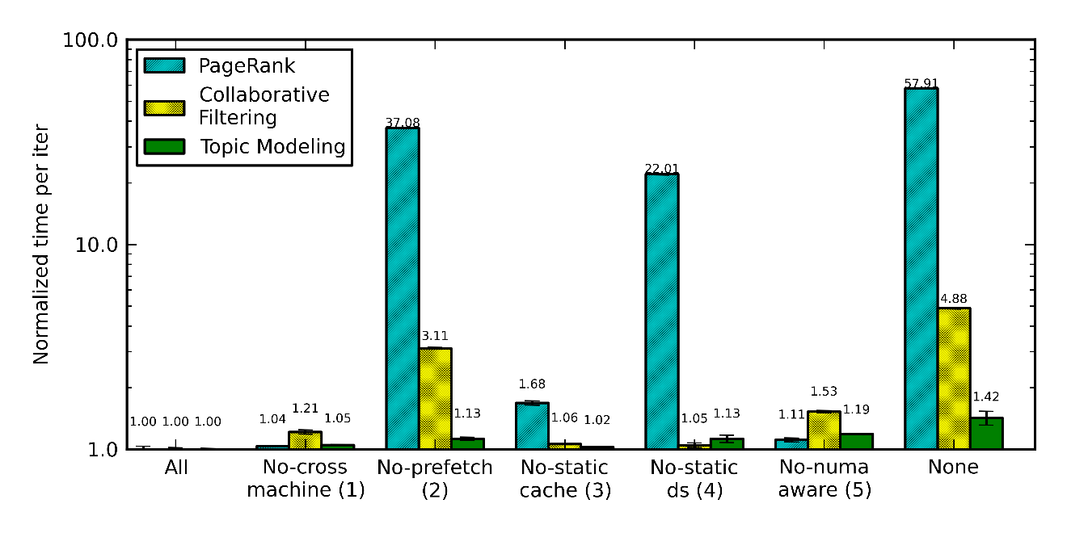
Optimization break down
Turn off one optimization each time
PR: prefetch + static_ds
PR: prefetch + static_ds CF: prefetch + numa_aware
Notes:
I will not go through each of the bars one by one. The important observation here is that different optimizations are most effective for different applications. (HIT) PageRank benefits most from prefetching and static data structures, (HIT) and collaborative filtering benefits most from prefetching and numa-aware memory management.

